Slide 1
concrete marrow
mickey vescera

Slide 2
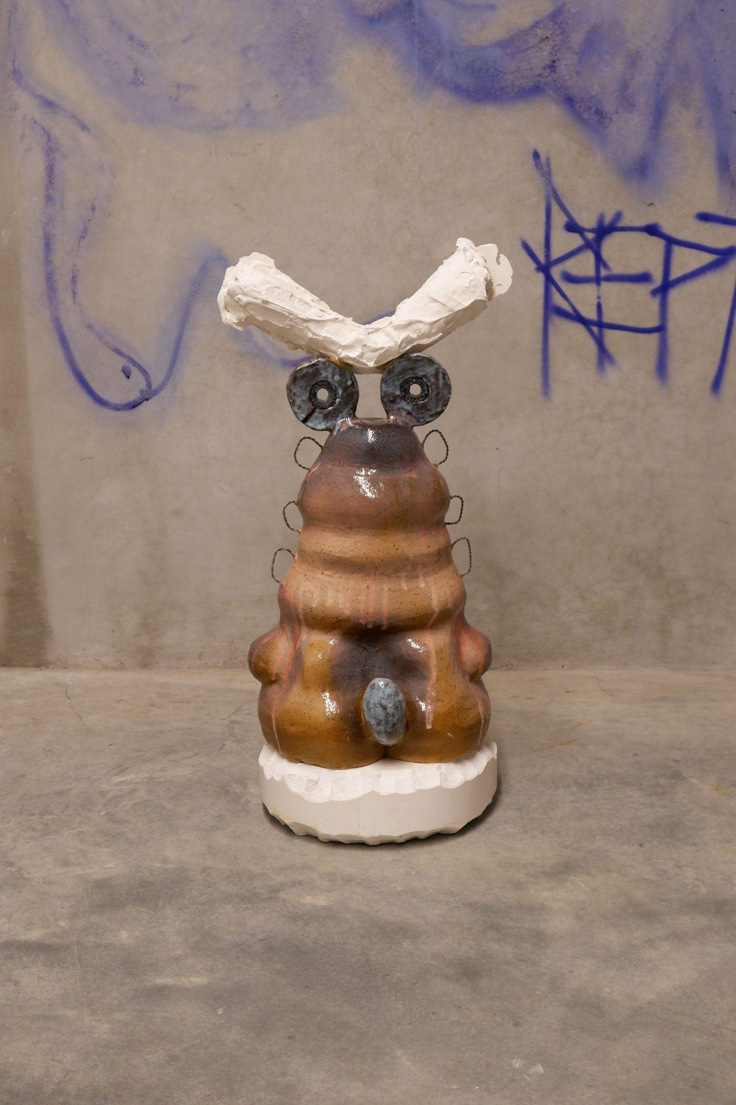
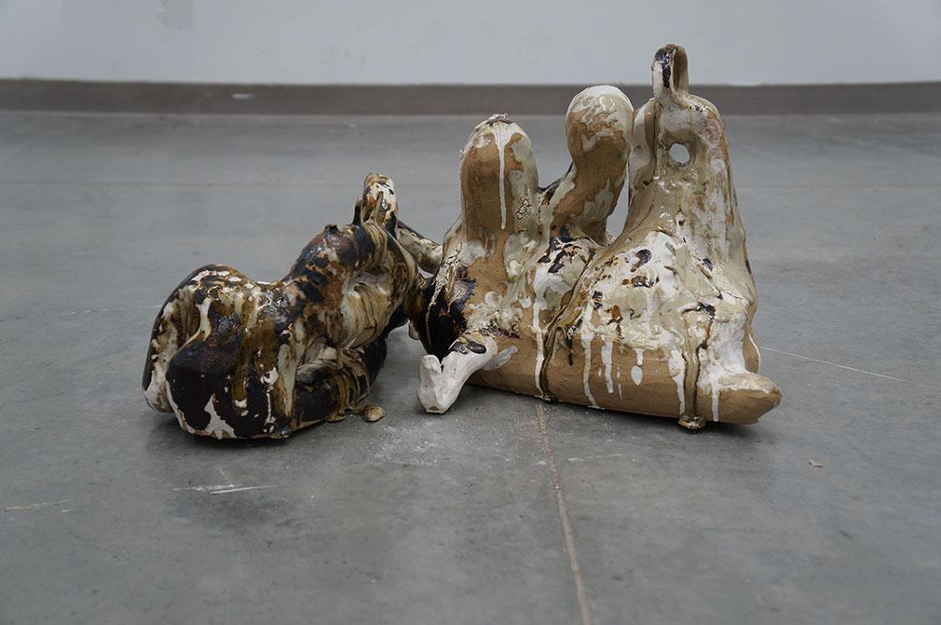
p-worm
ceramic, metal, plaster; 2021
HORSE
ceramic; 2020

Slide 3
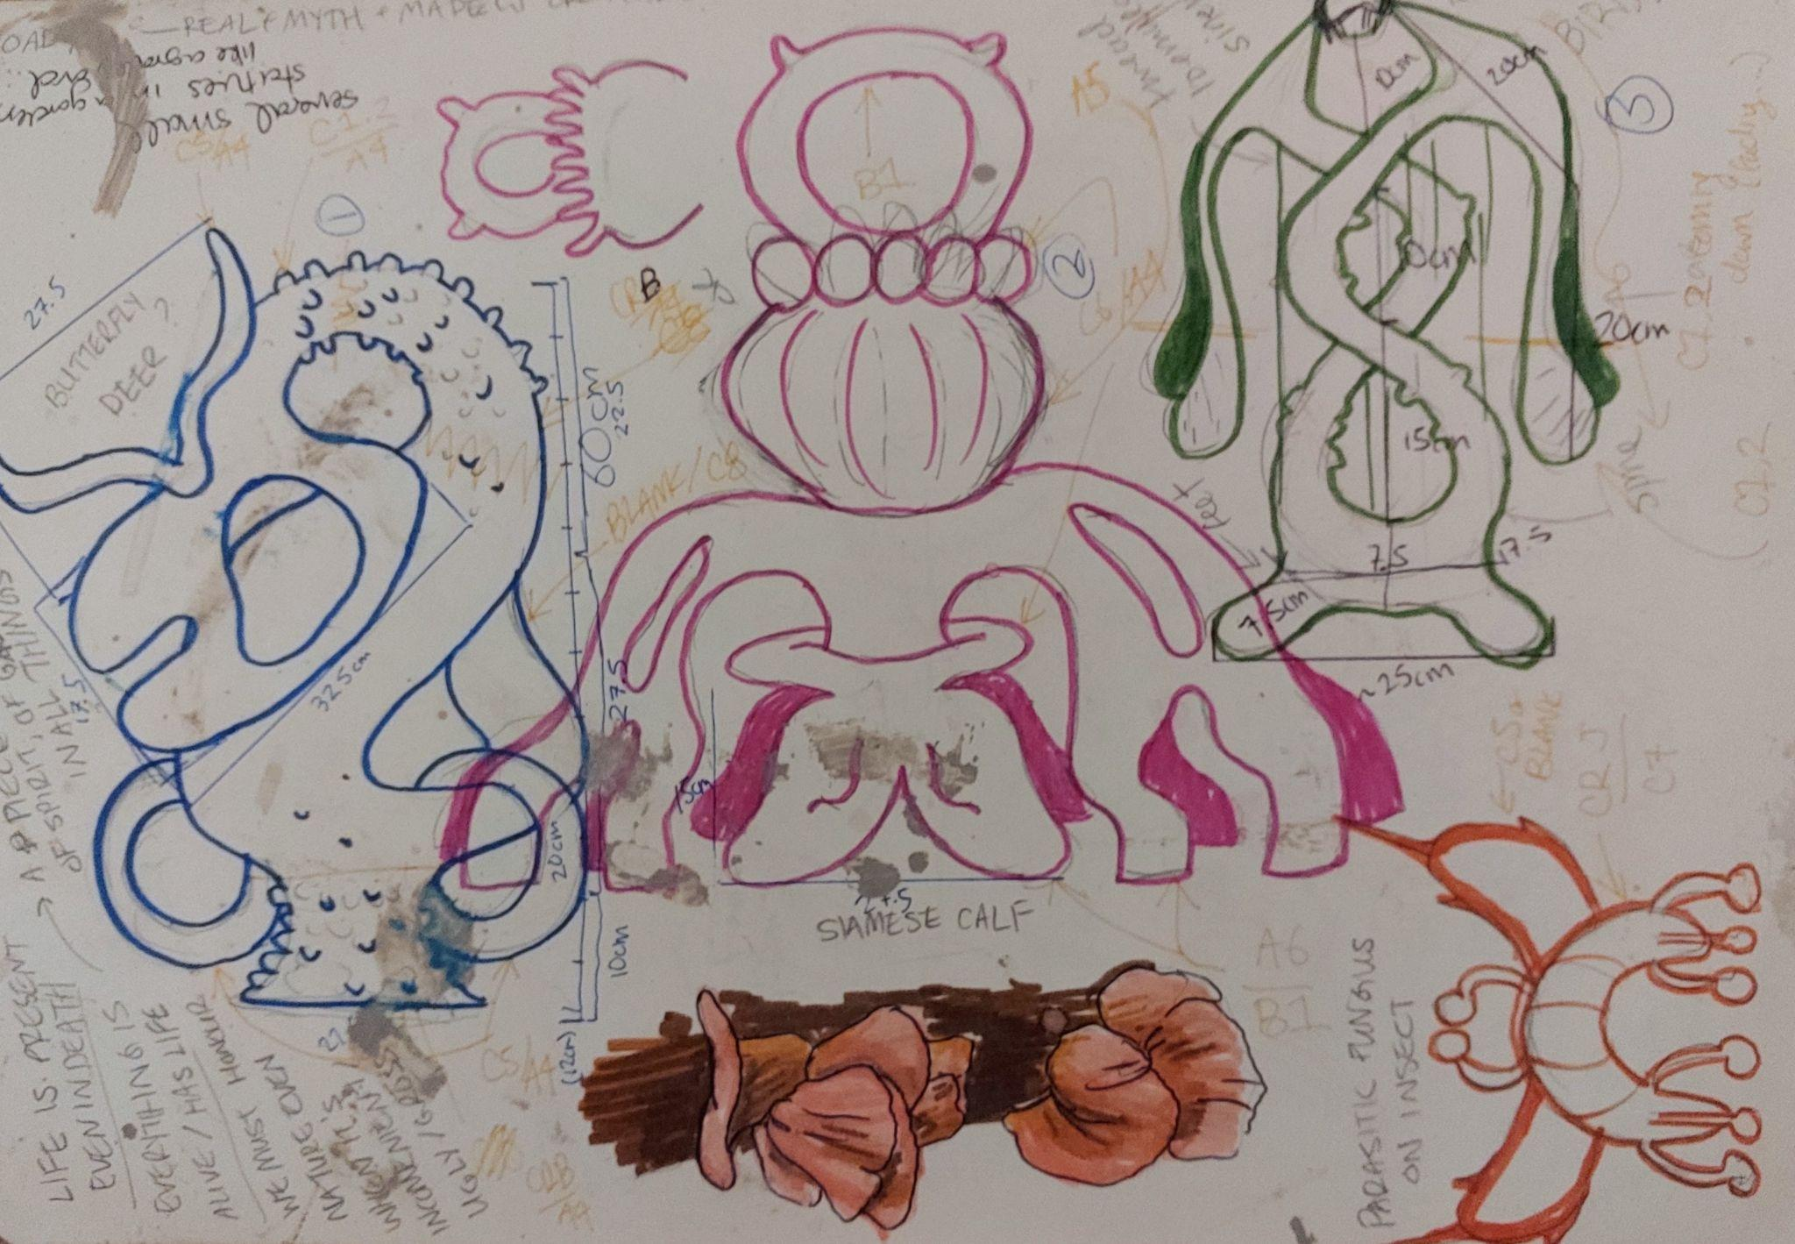

Slide 4
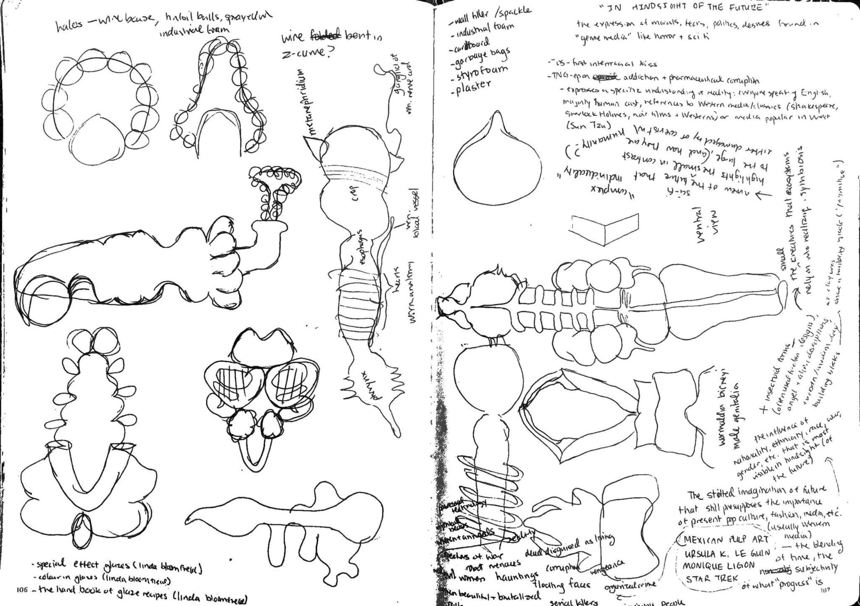
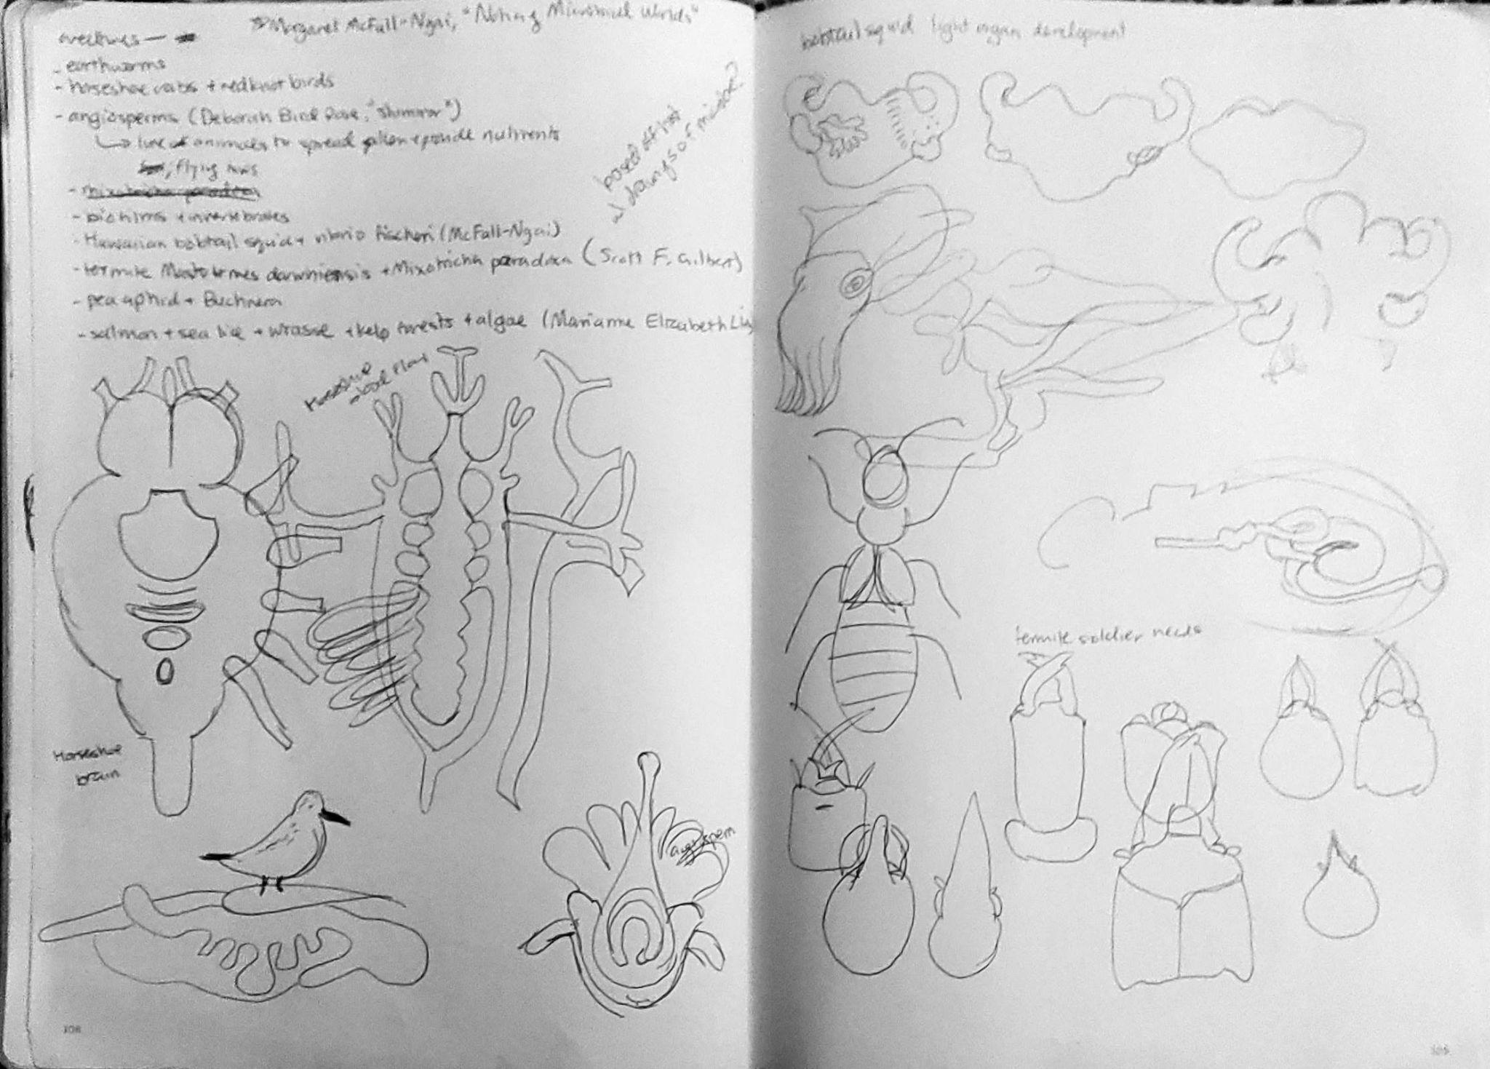

Slide 5
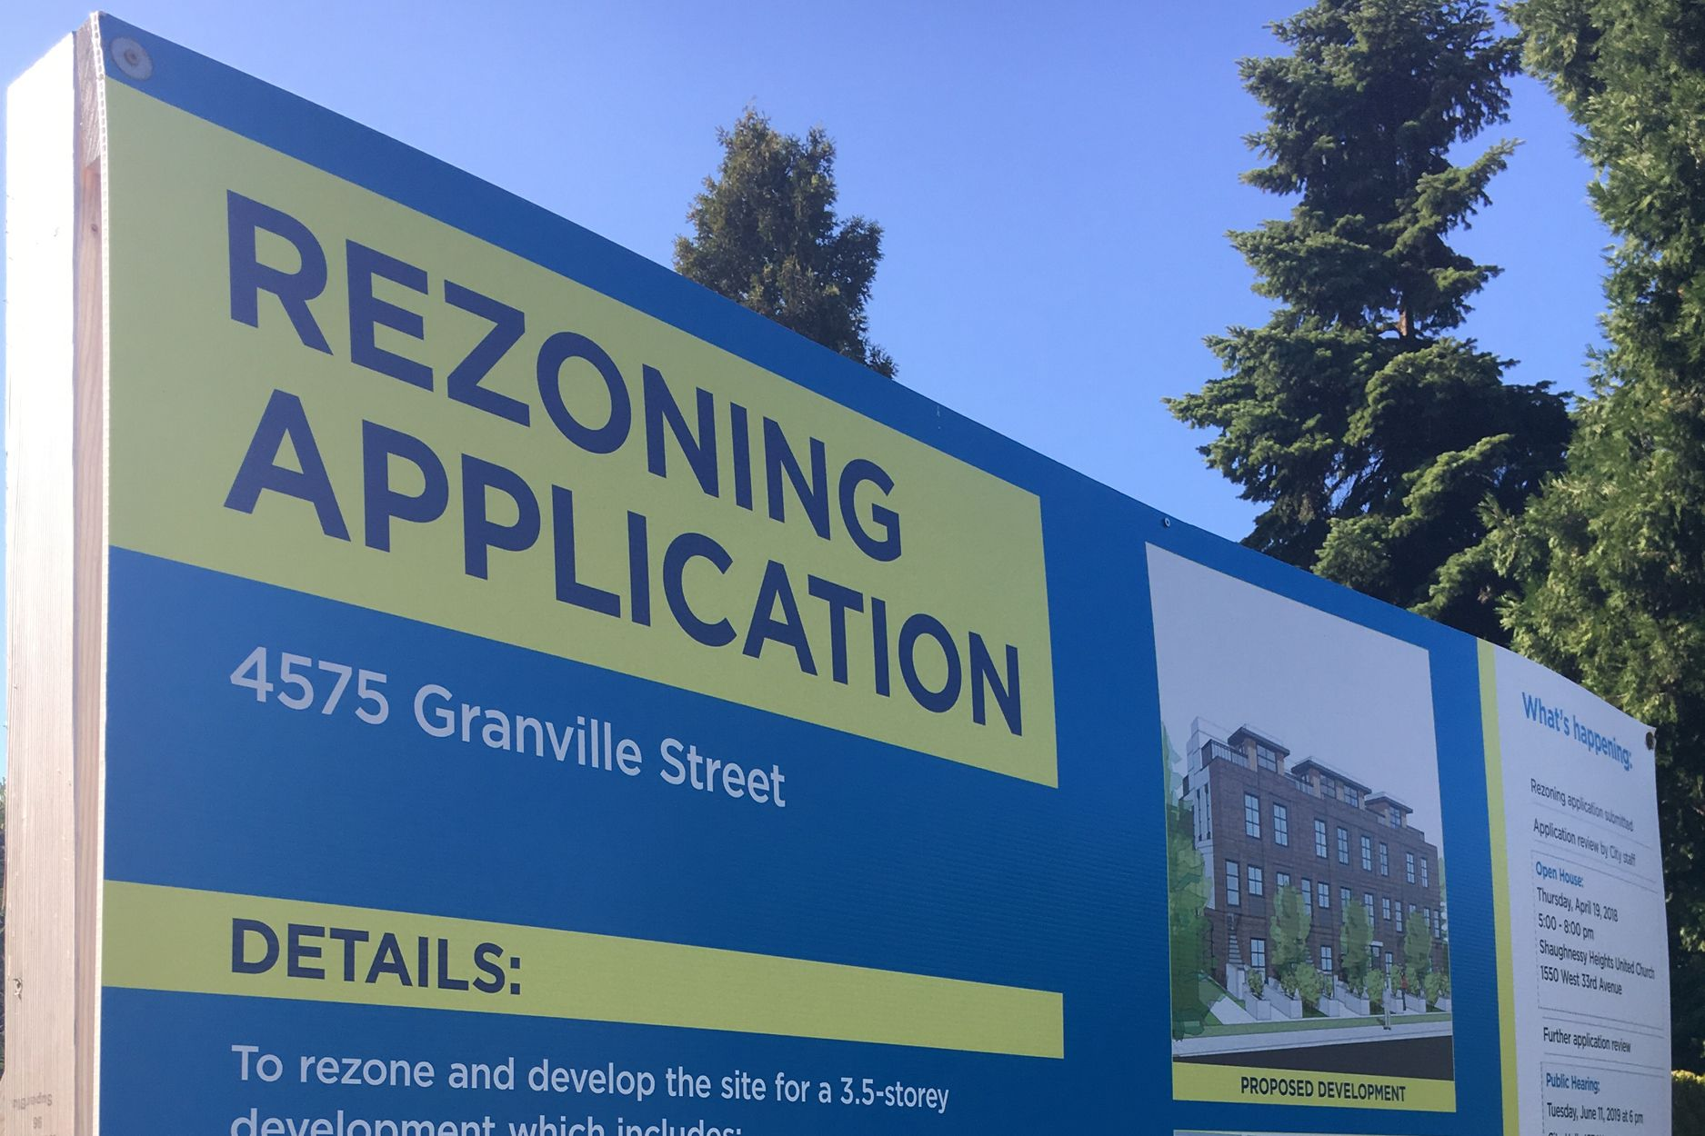
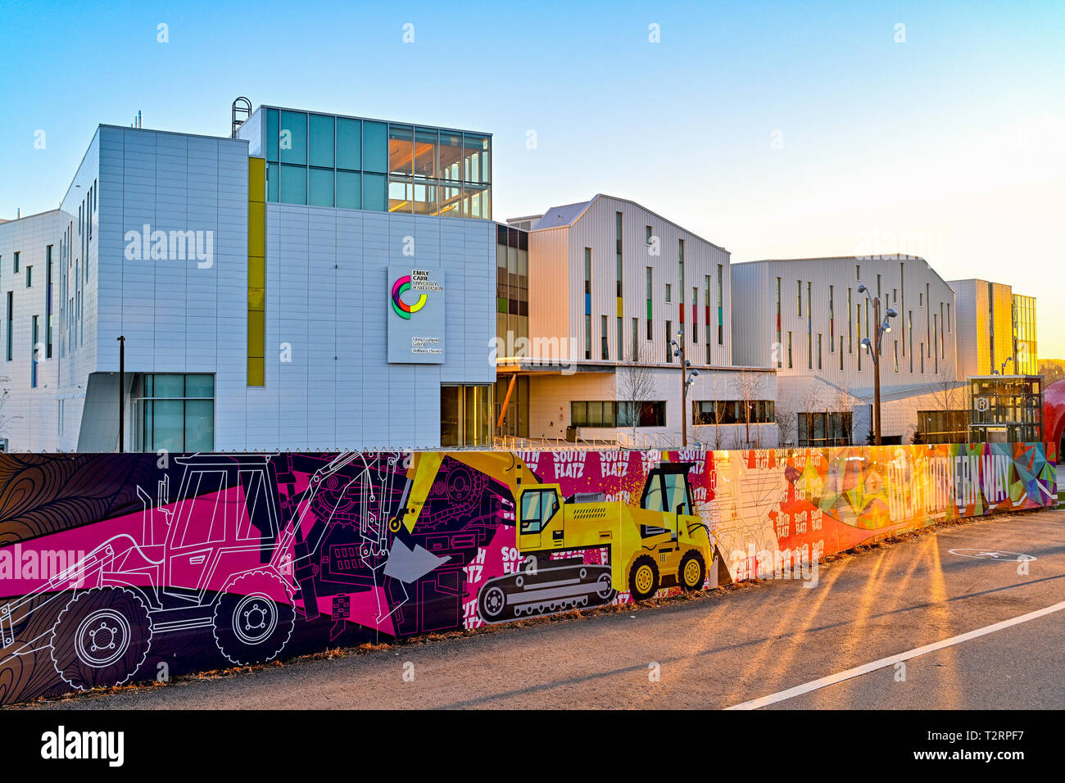
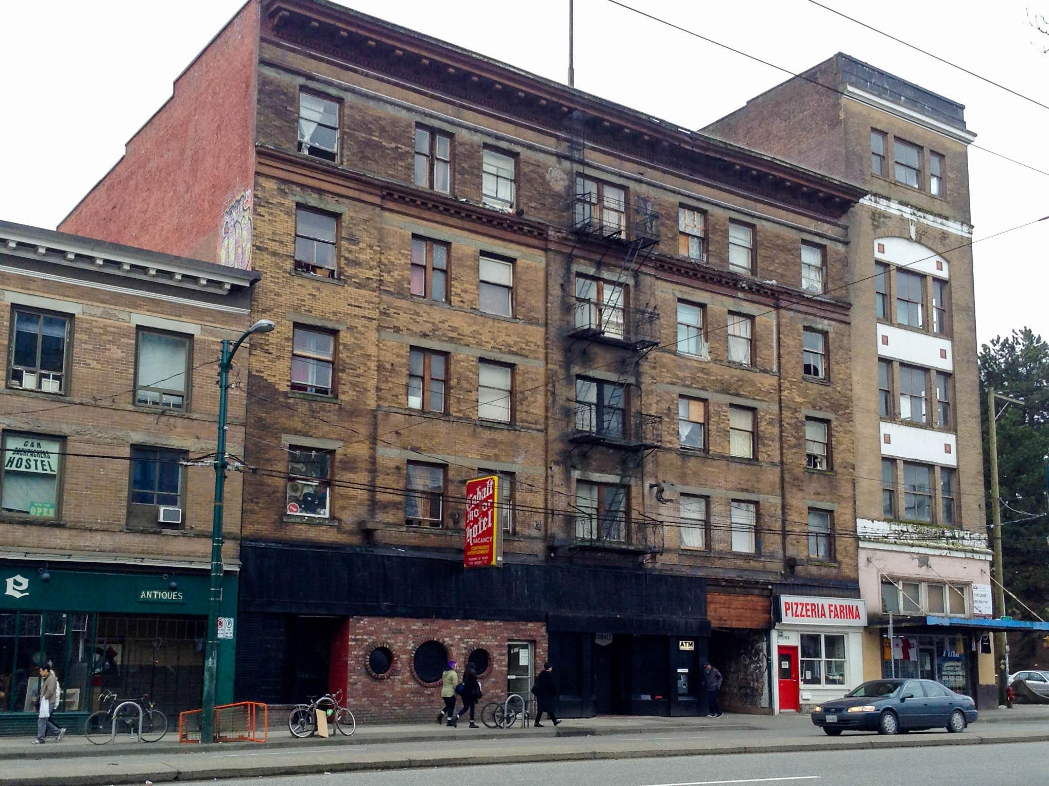
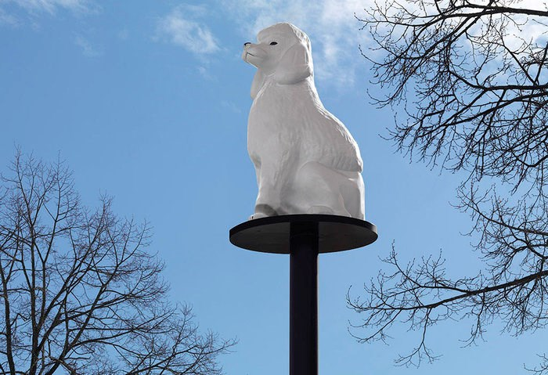

Slide 6
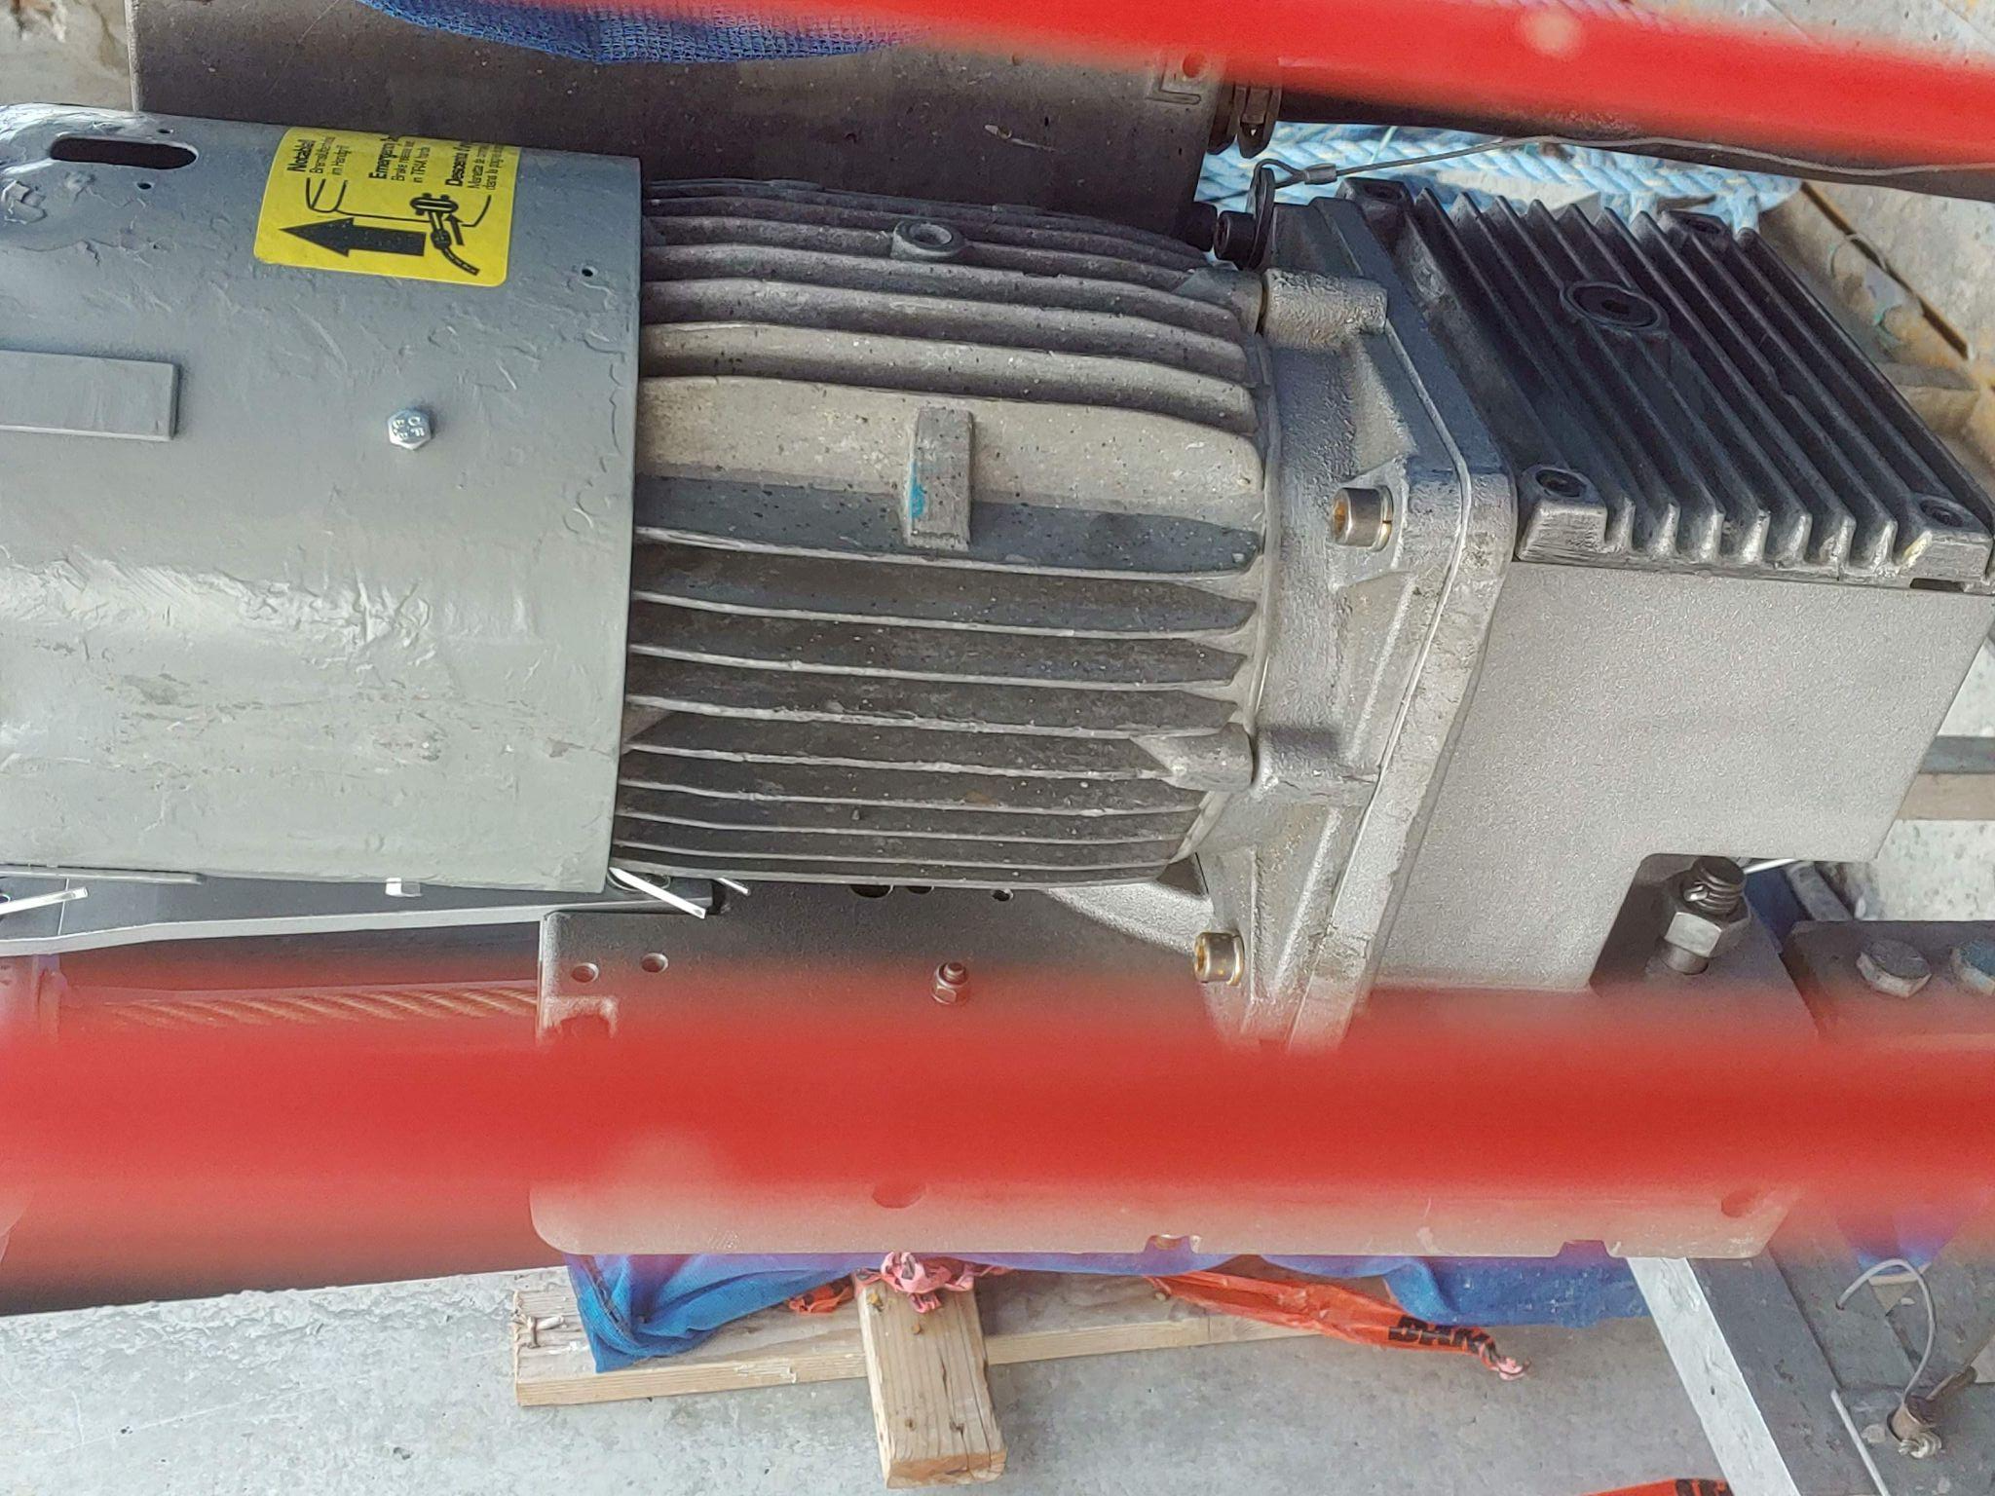
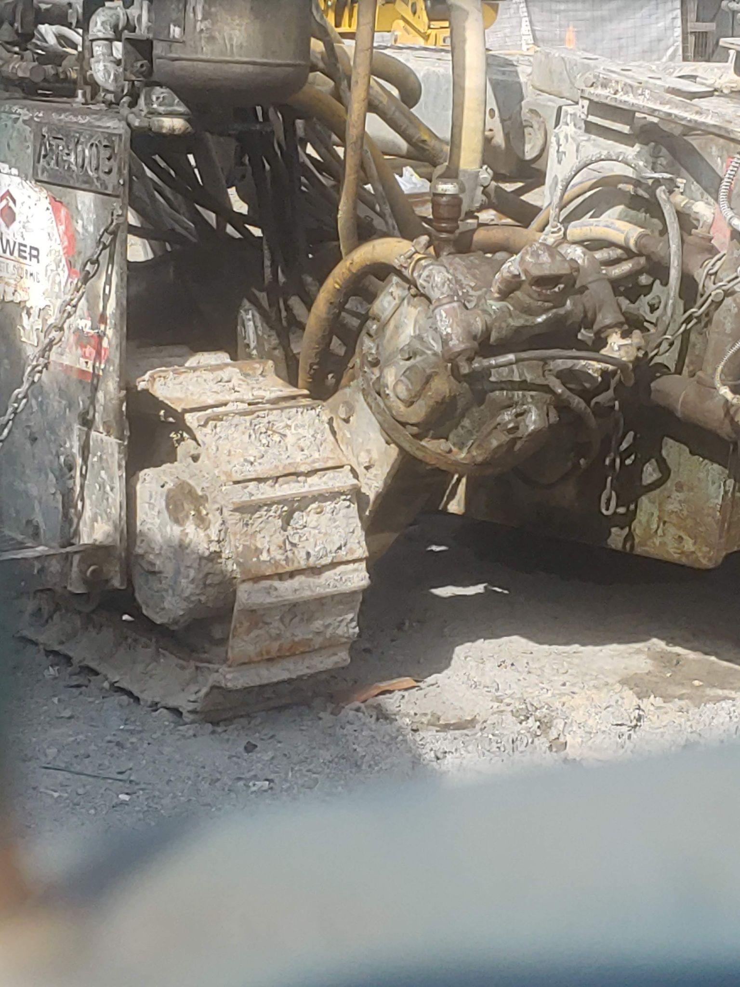
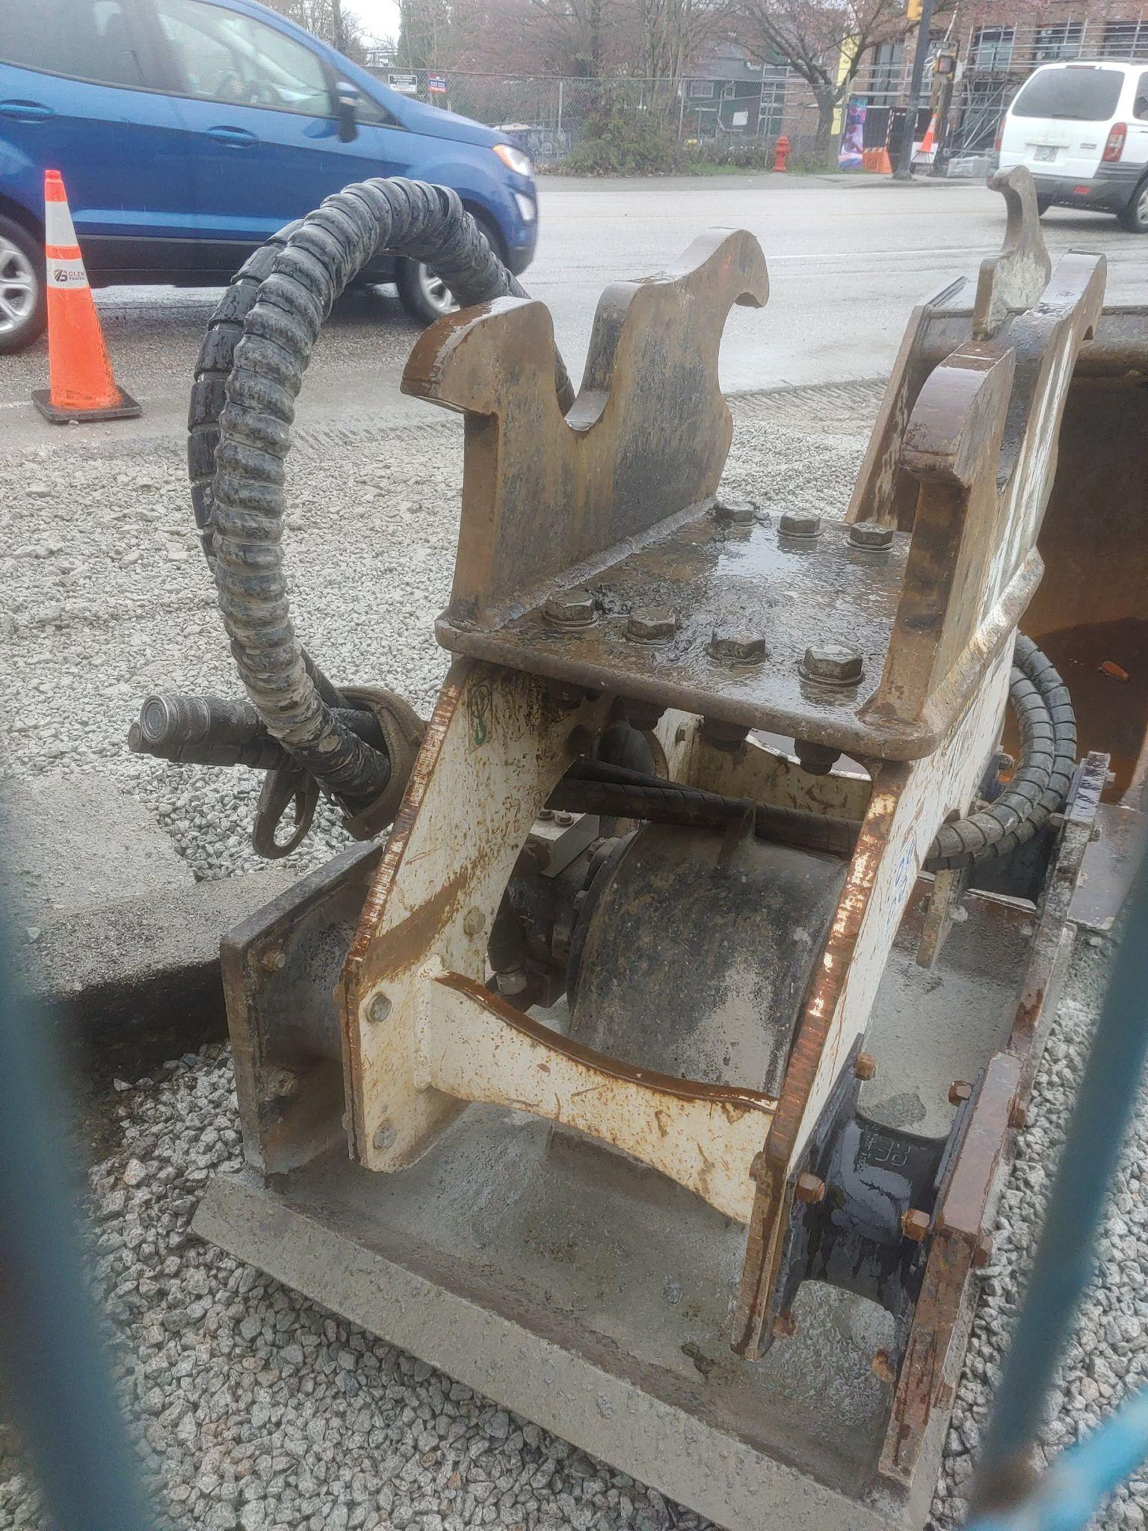
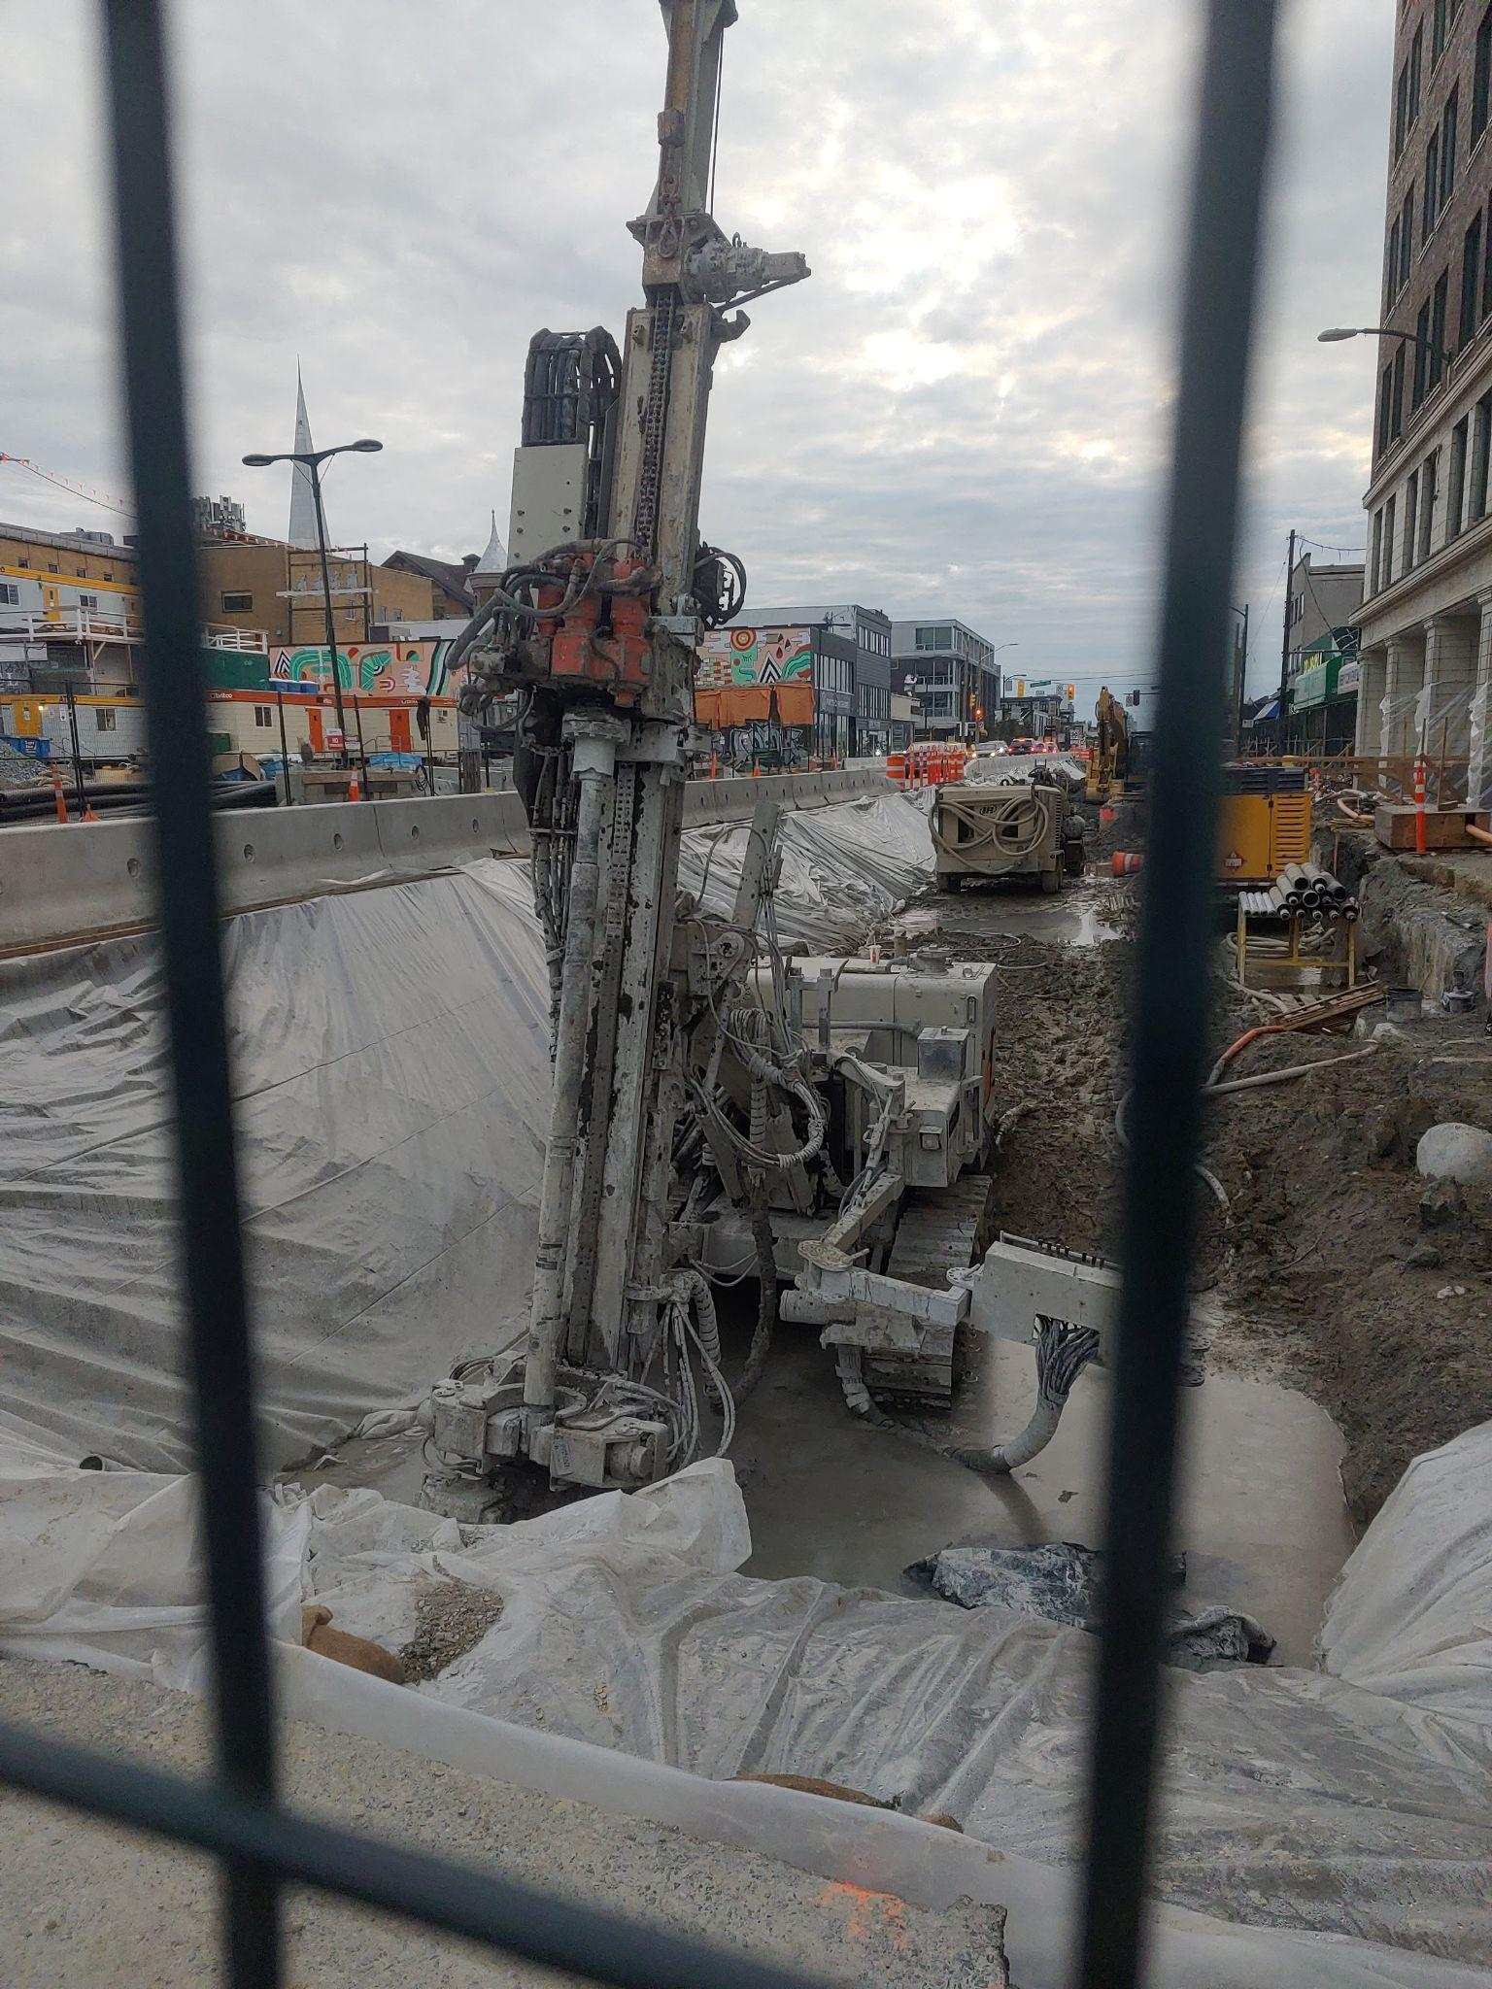
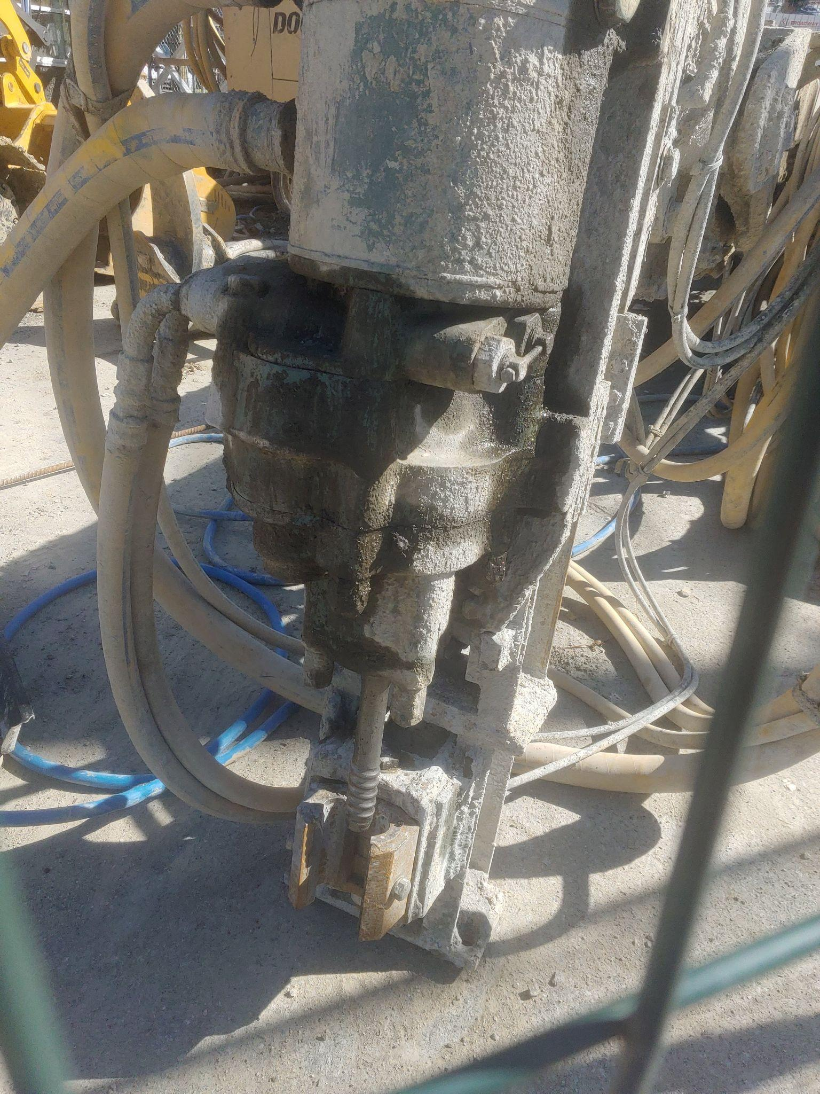
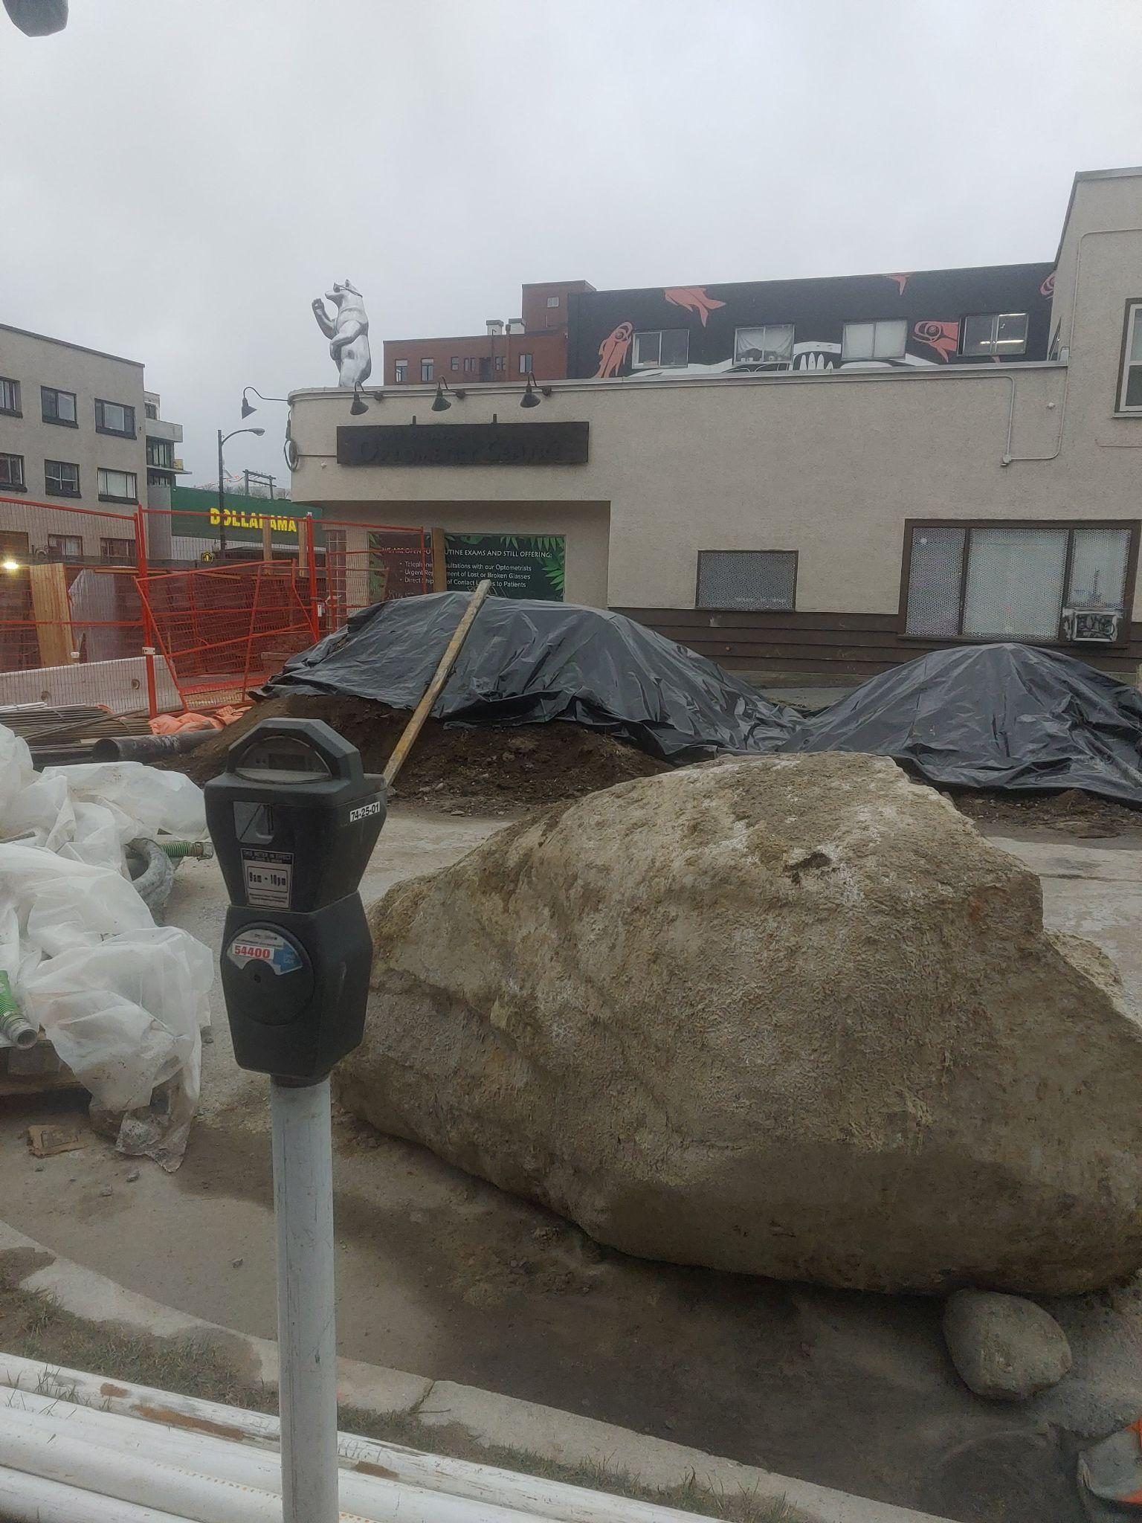
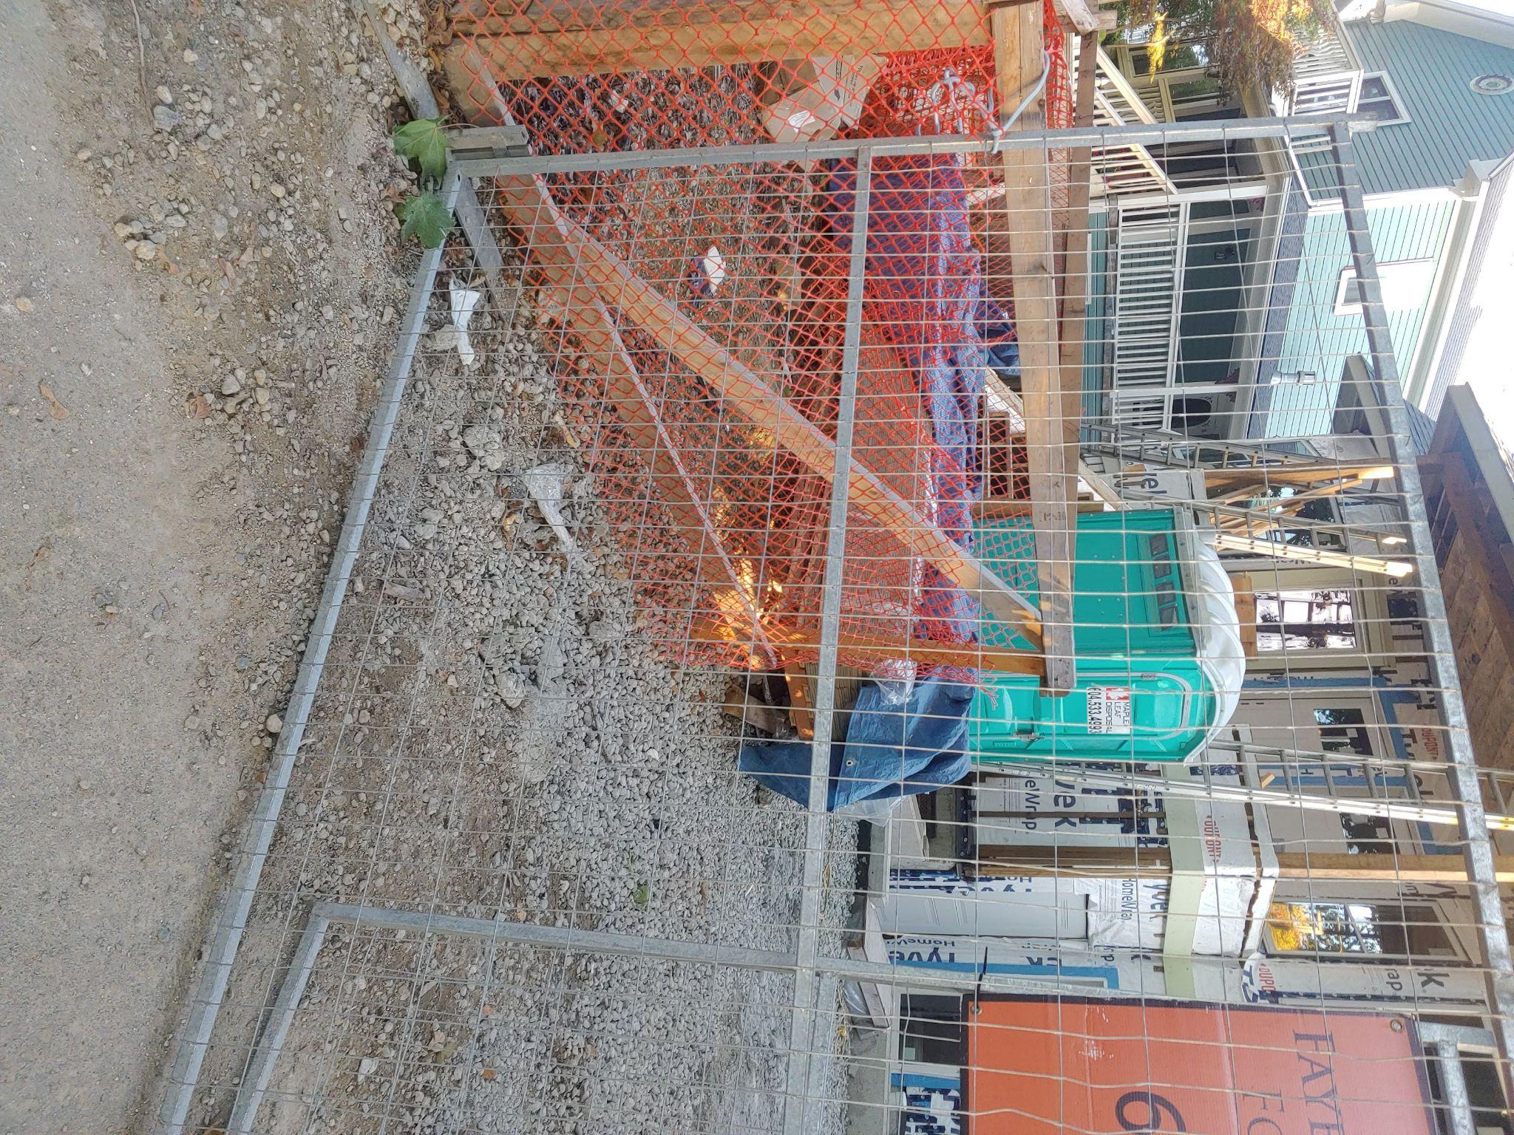

Slide 7
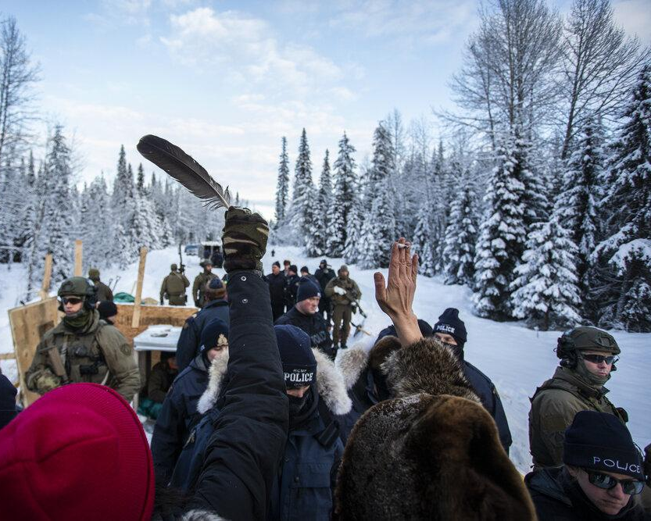
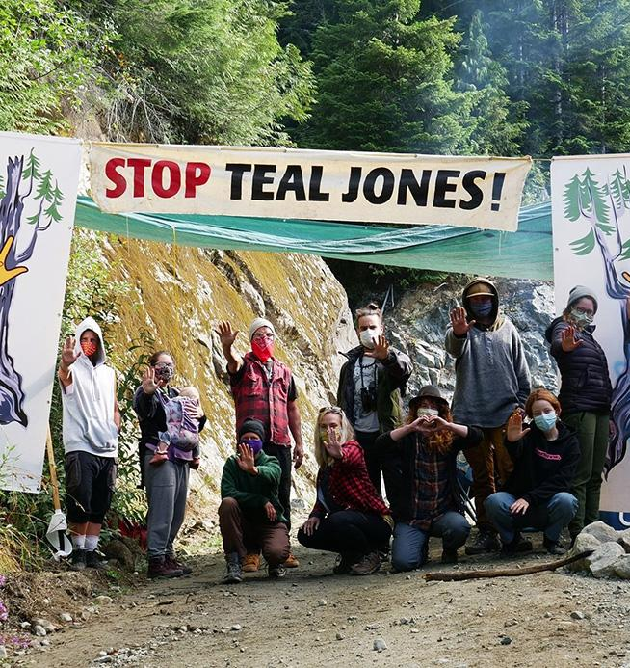

Slide 8
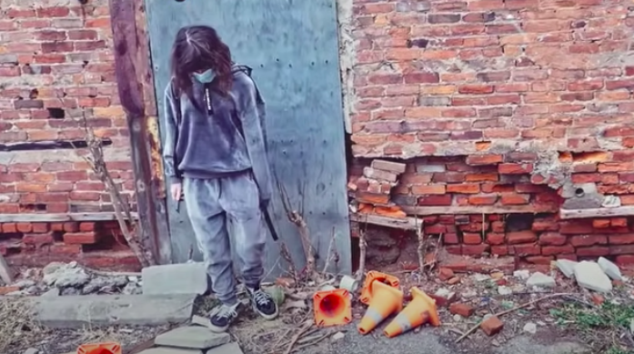
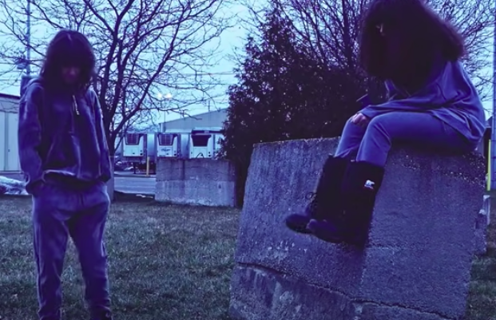
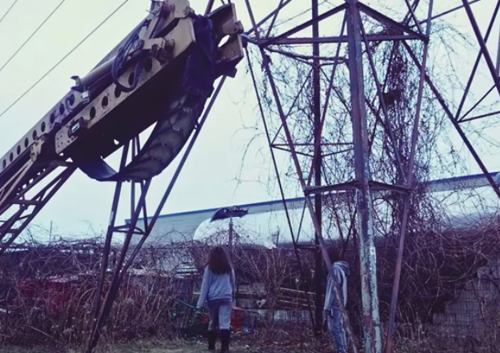
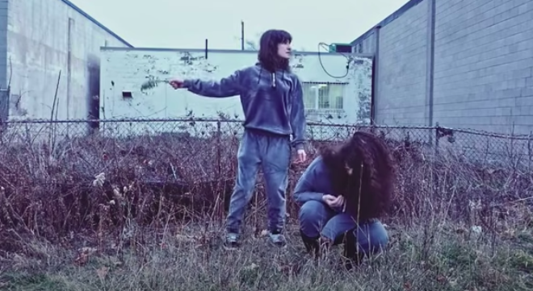

Slide 9
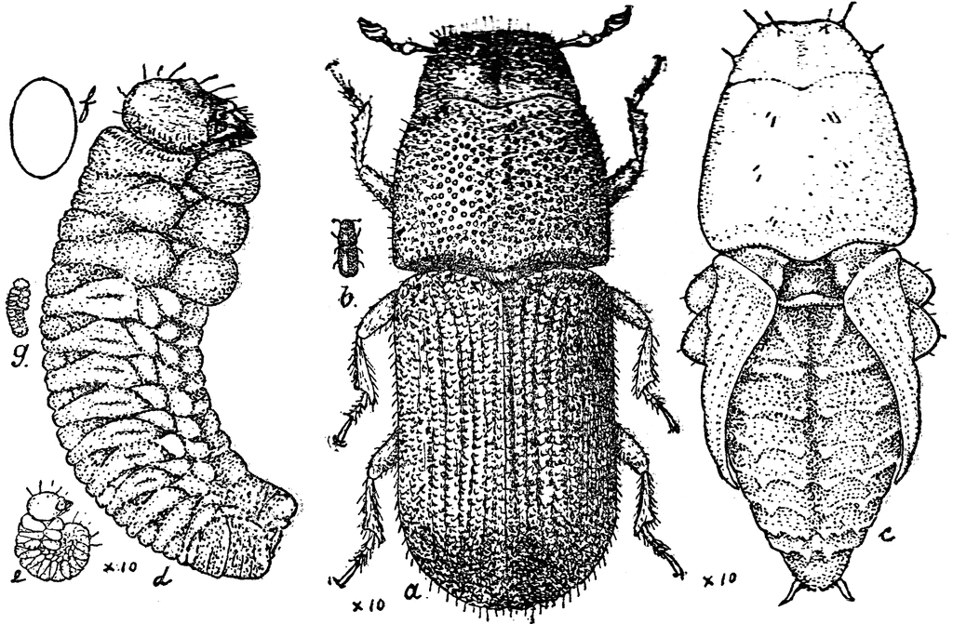
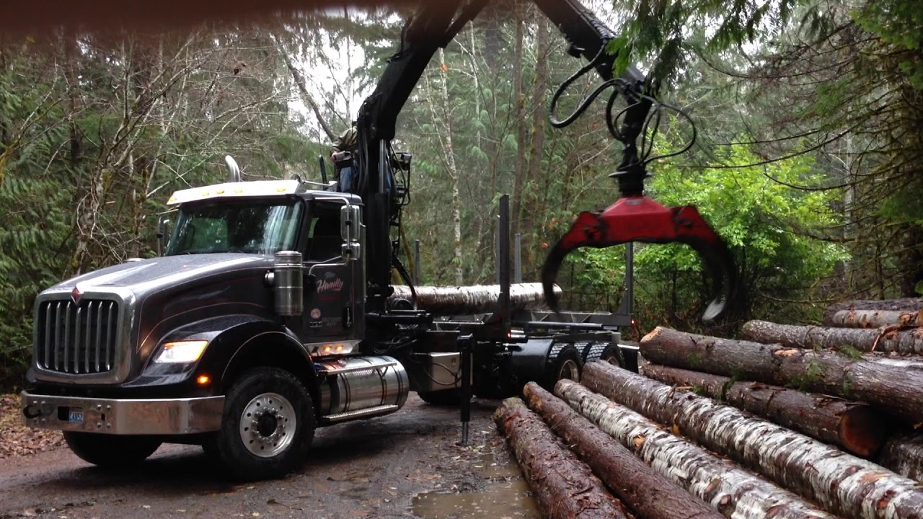
pine beetle
United States, Department of Agriculture. Yearbook of the United States Department of Agriculture. Government Printing Office, 1903, pp. 270.
log picking truck
“2017 International HX self loader log truck.” YouTube, uploaded by Daniel Boone’s logging videos, 3 Dec 2017, https://www.youtube.com/watch?v=YITFR9CJkwI.
Notes:
log picker

Slide 10
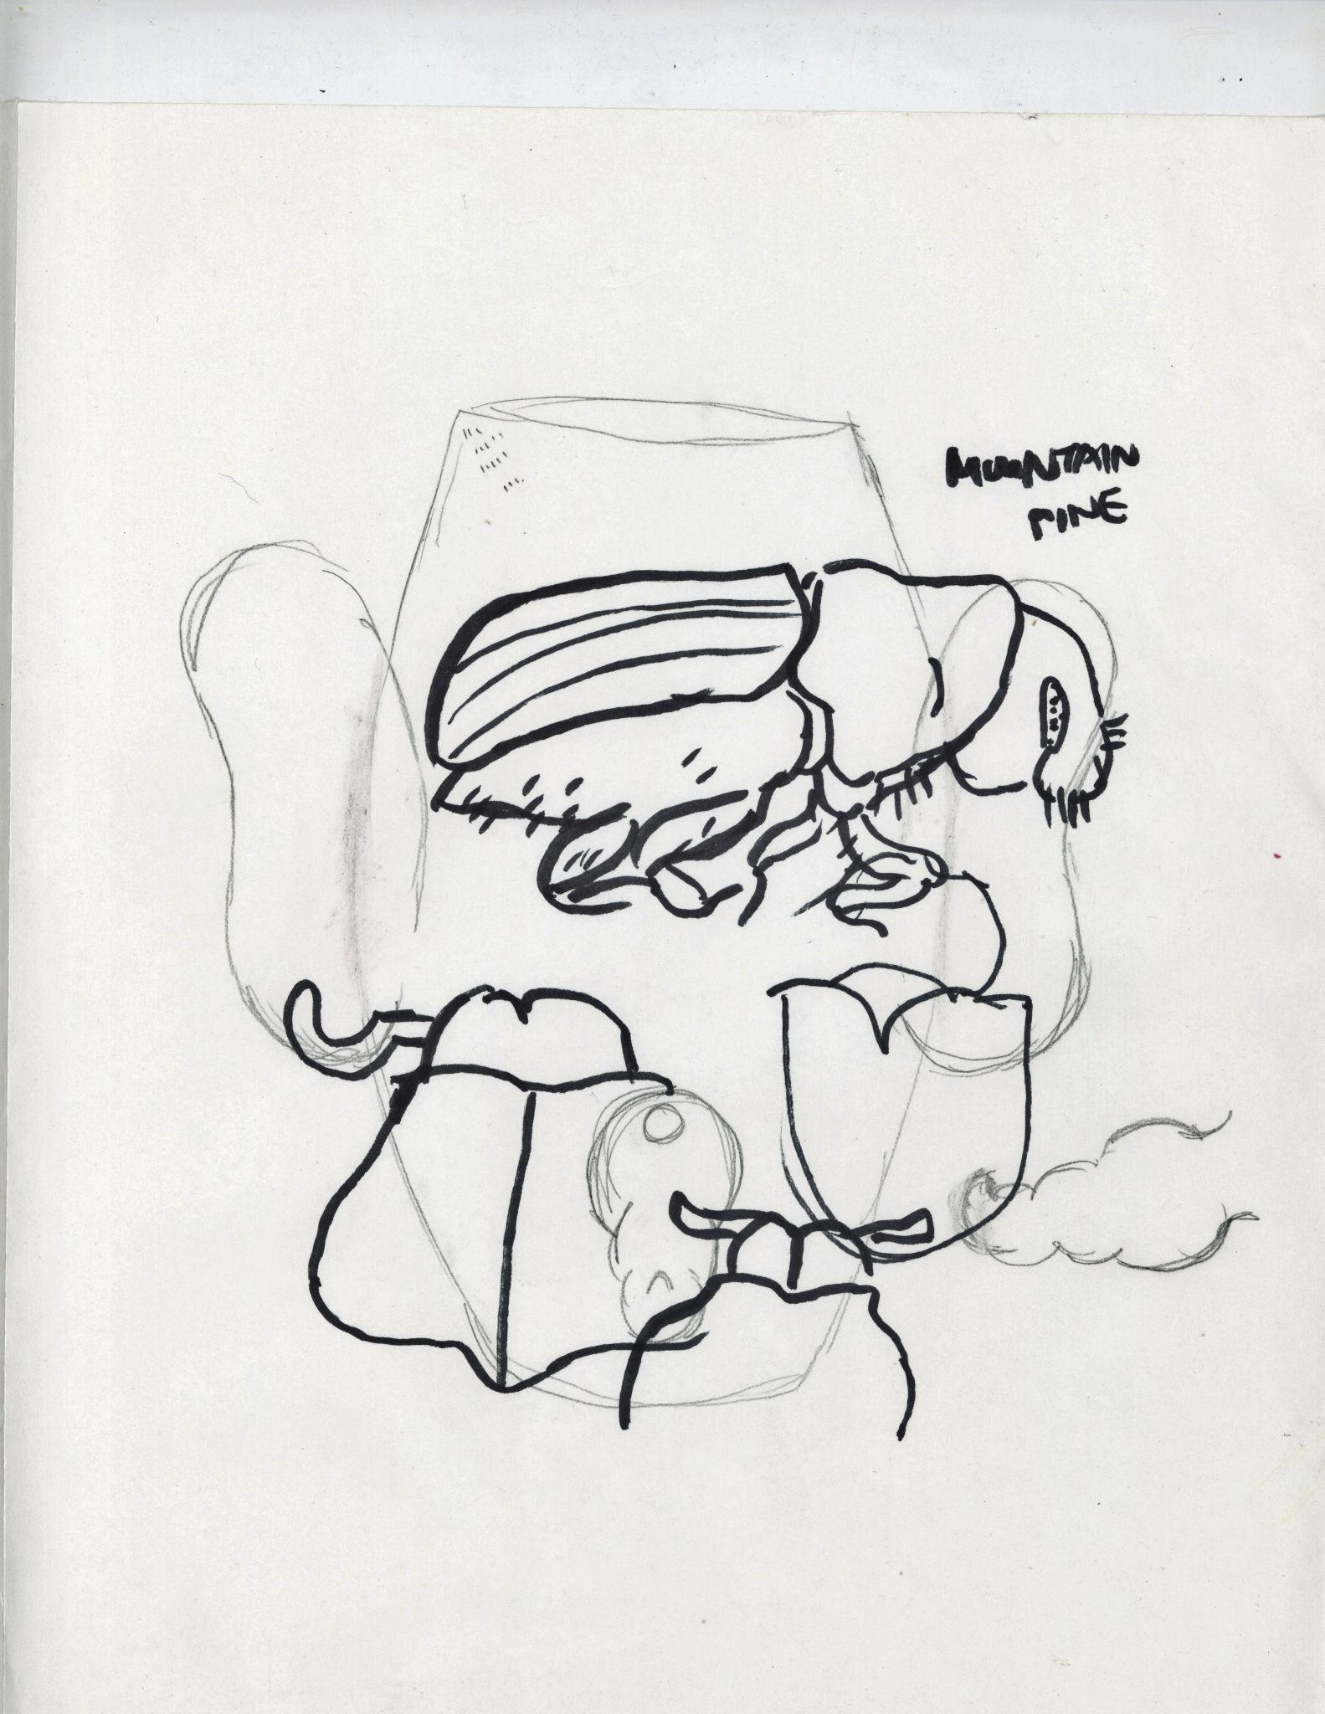
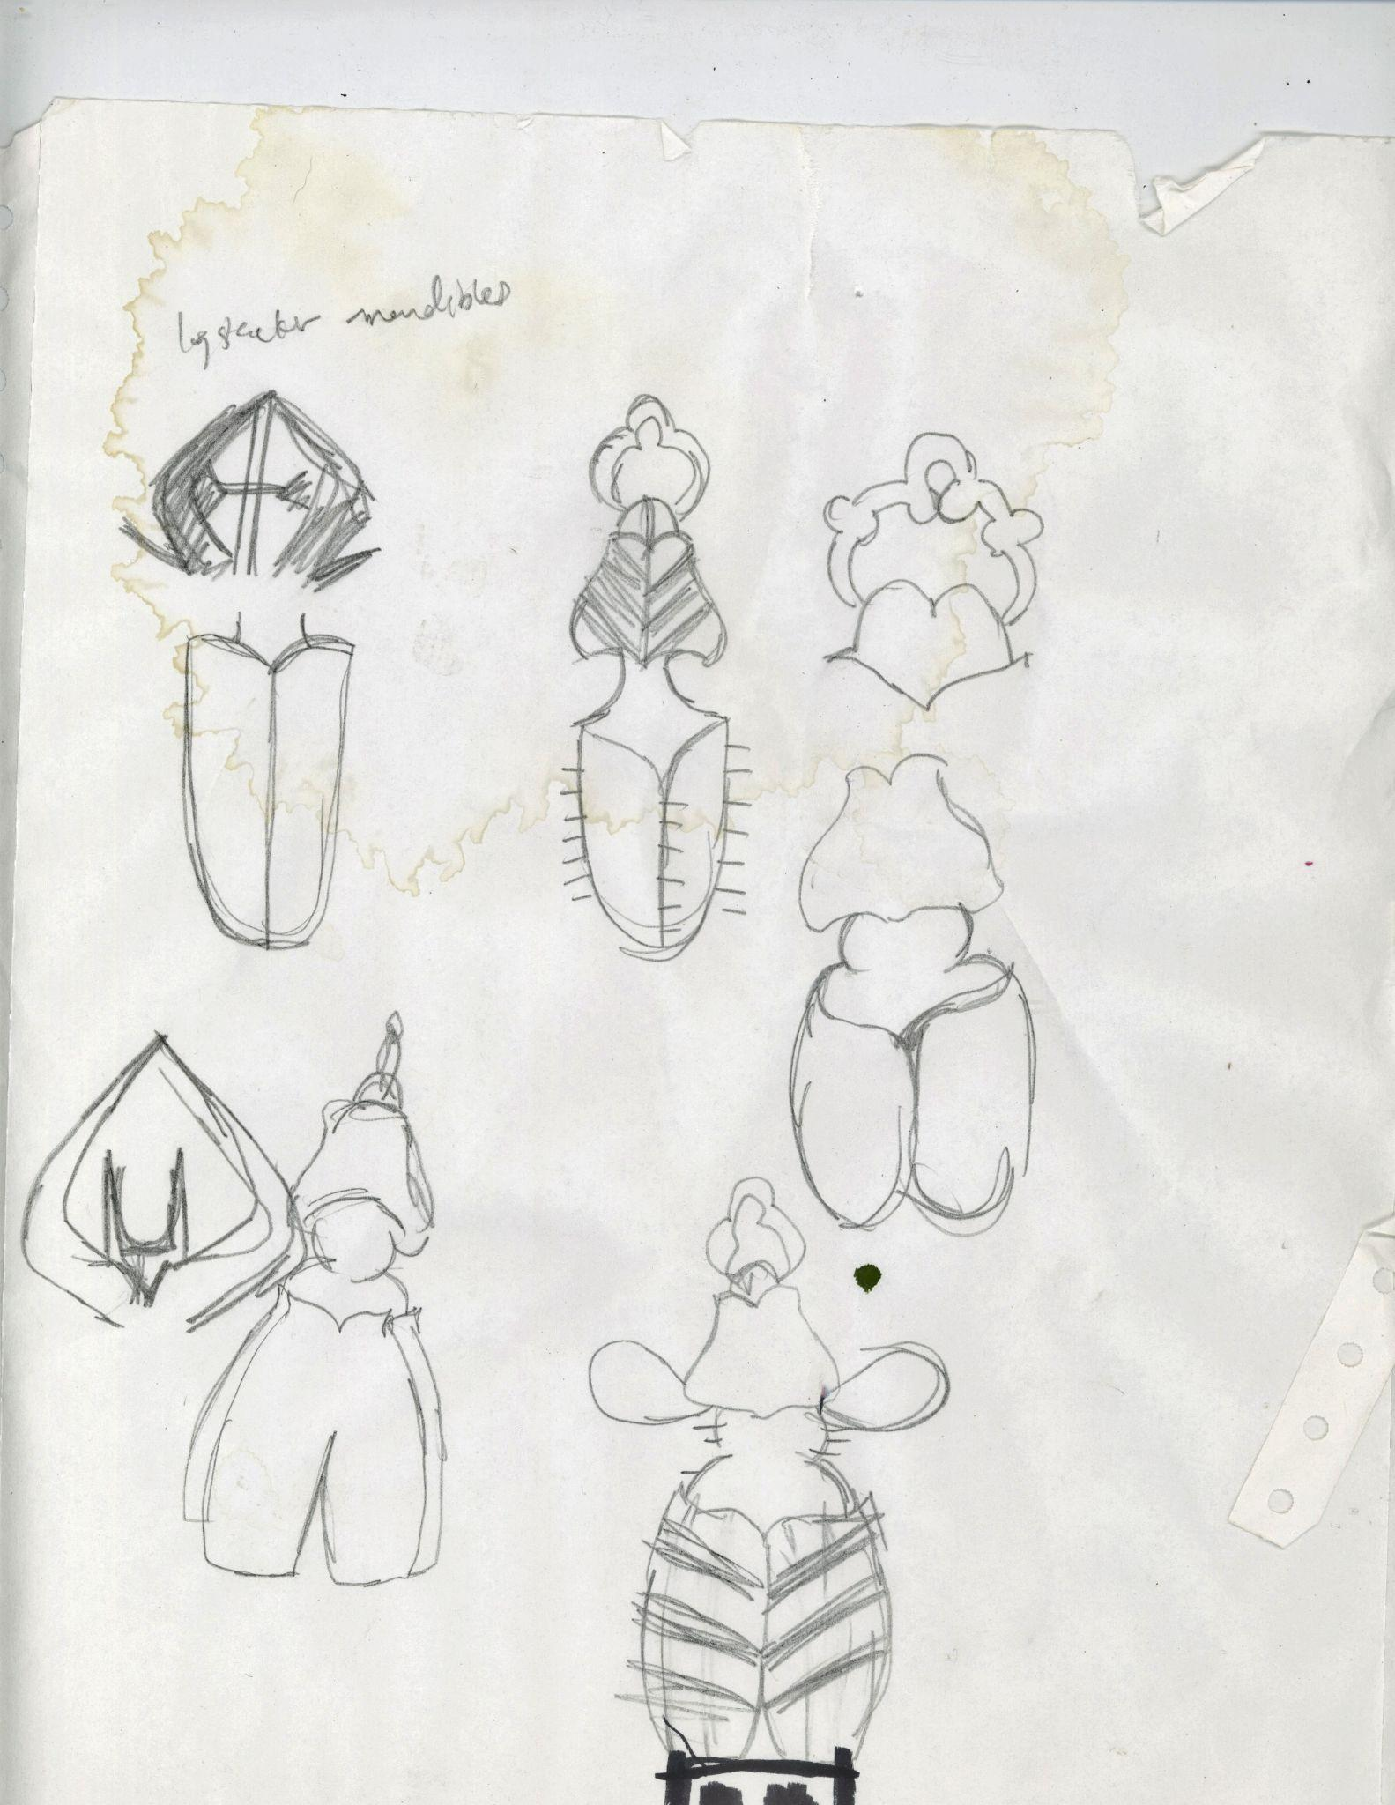

Slide 11
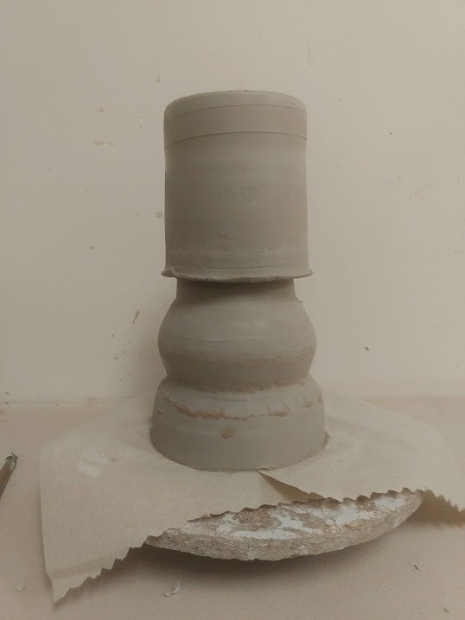
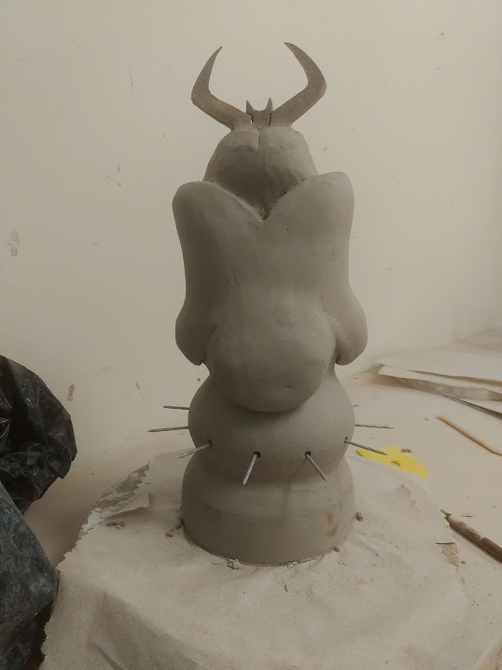
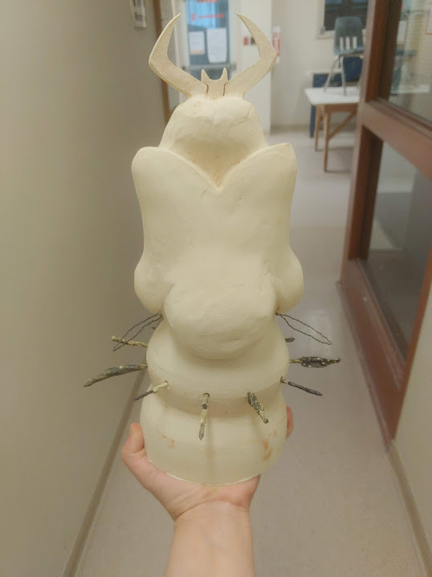

Slide 12
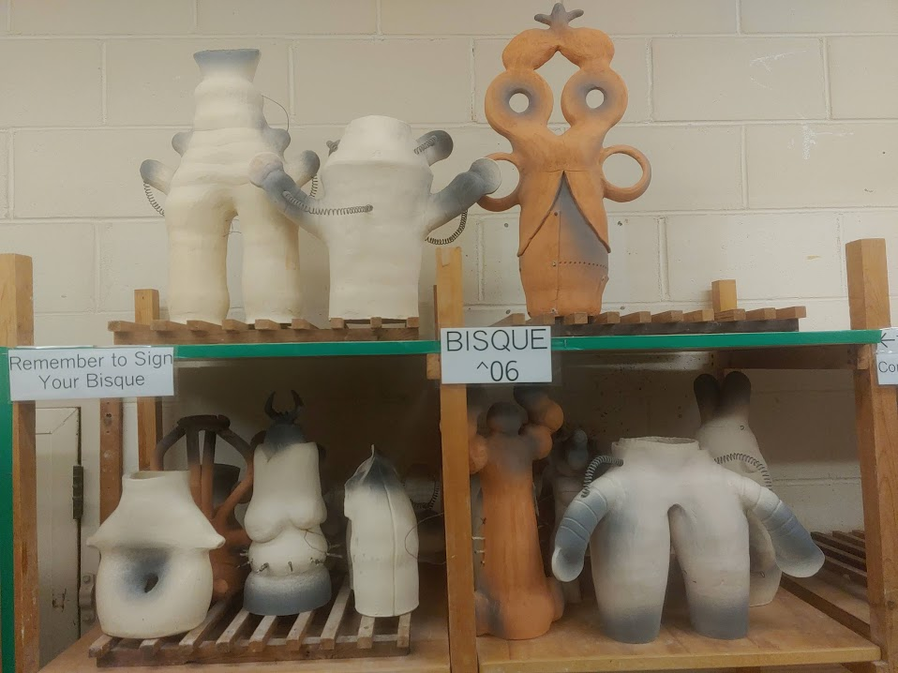

Slide 13
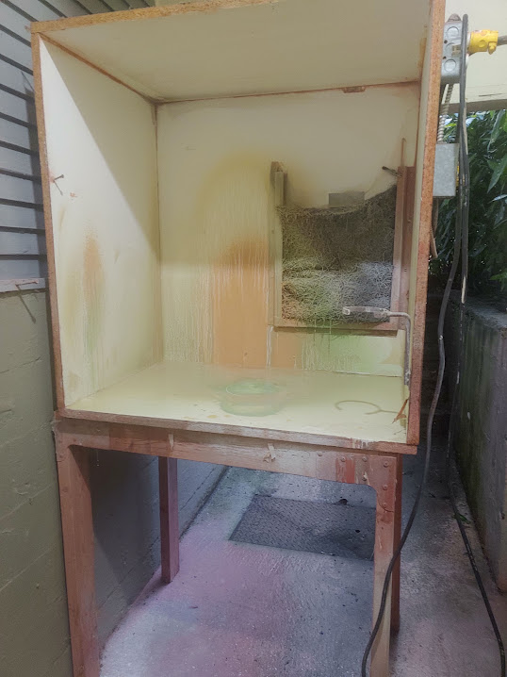
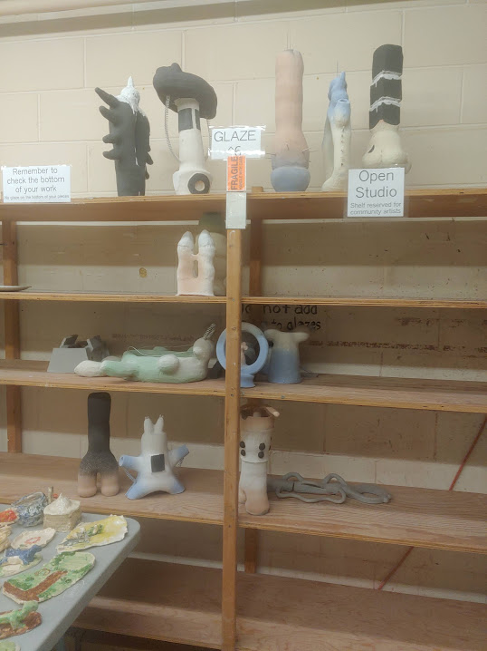

Slide 14
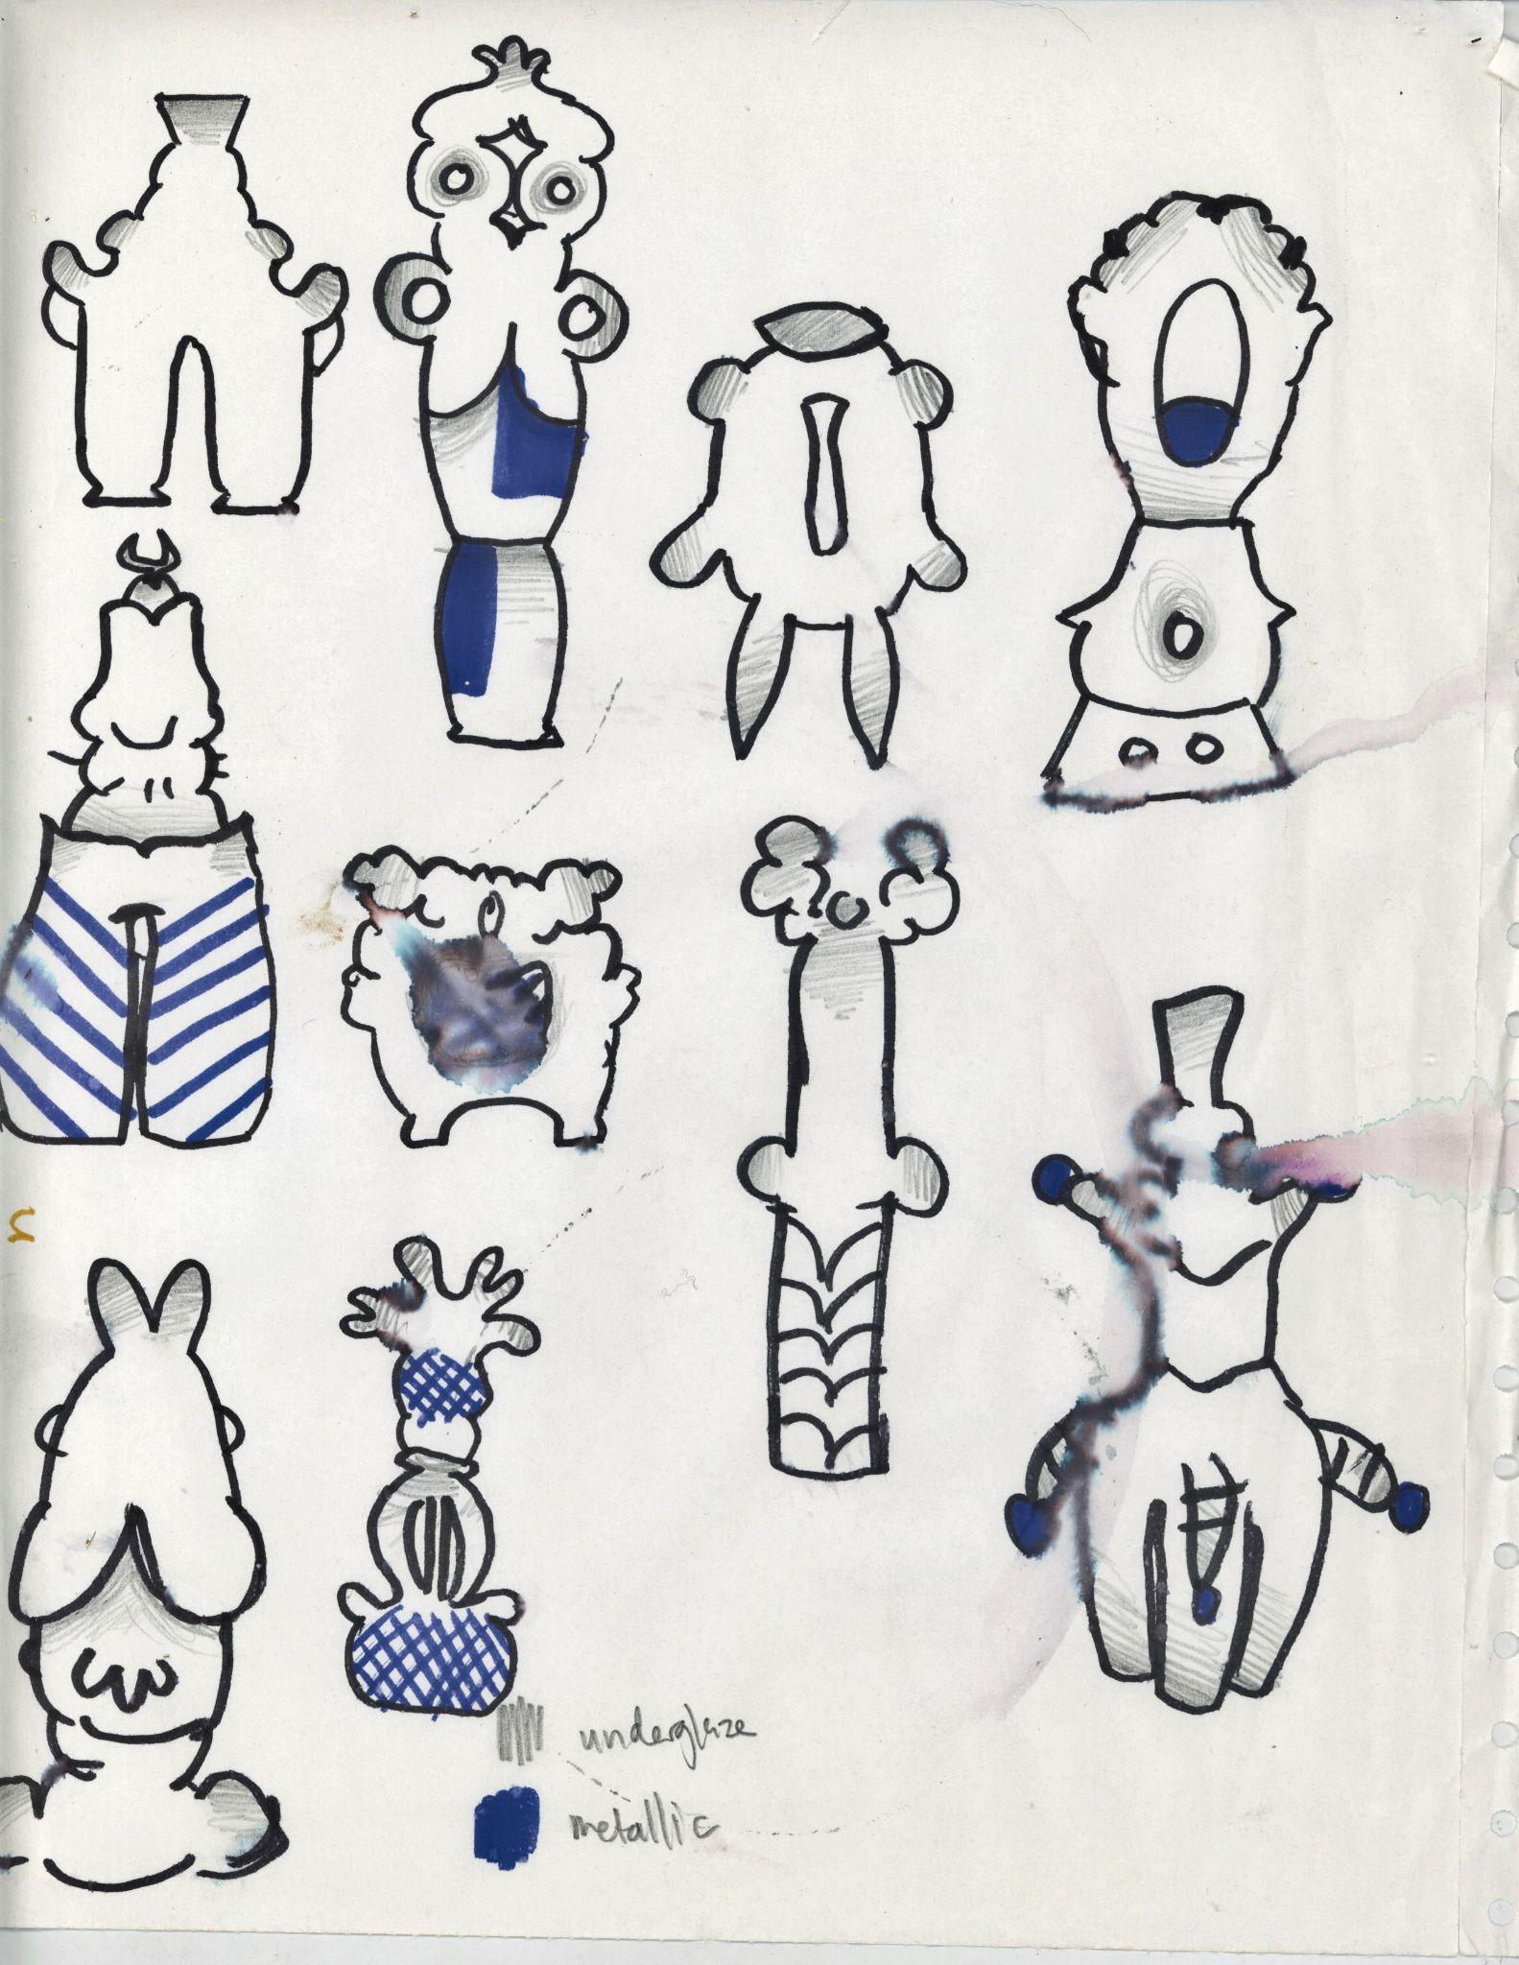
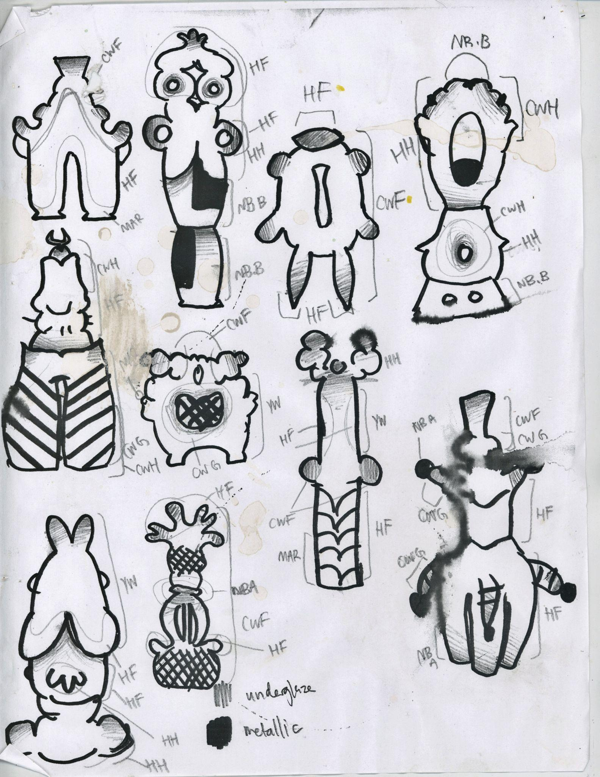
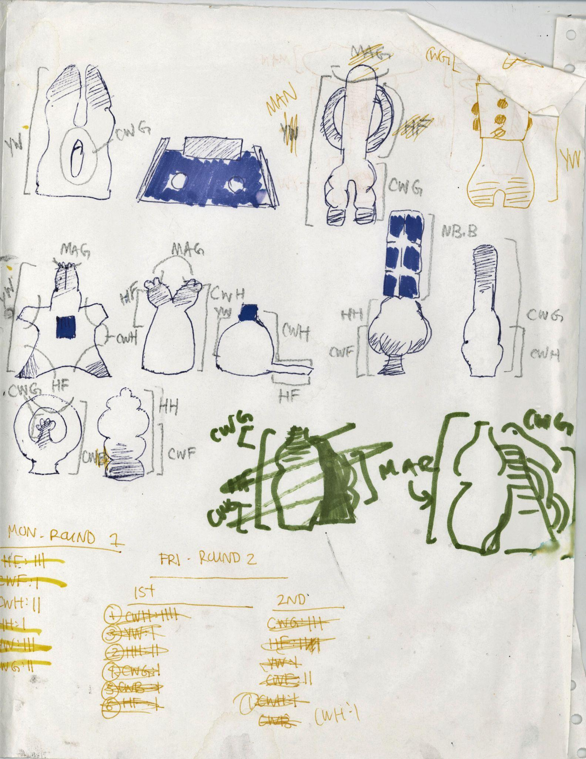

Slide 15
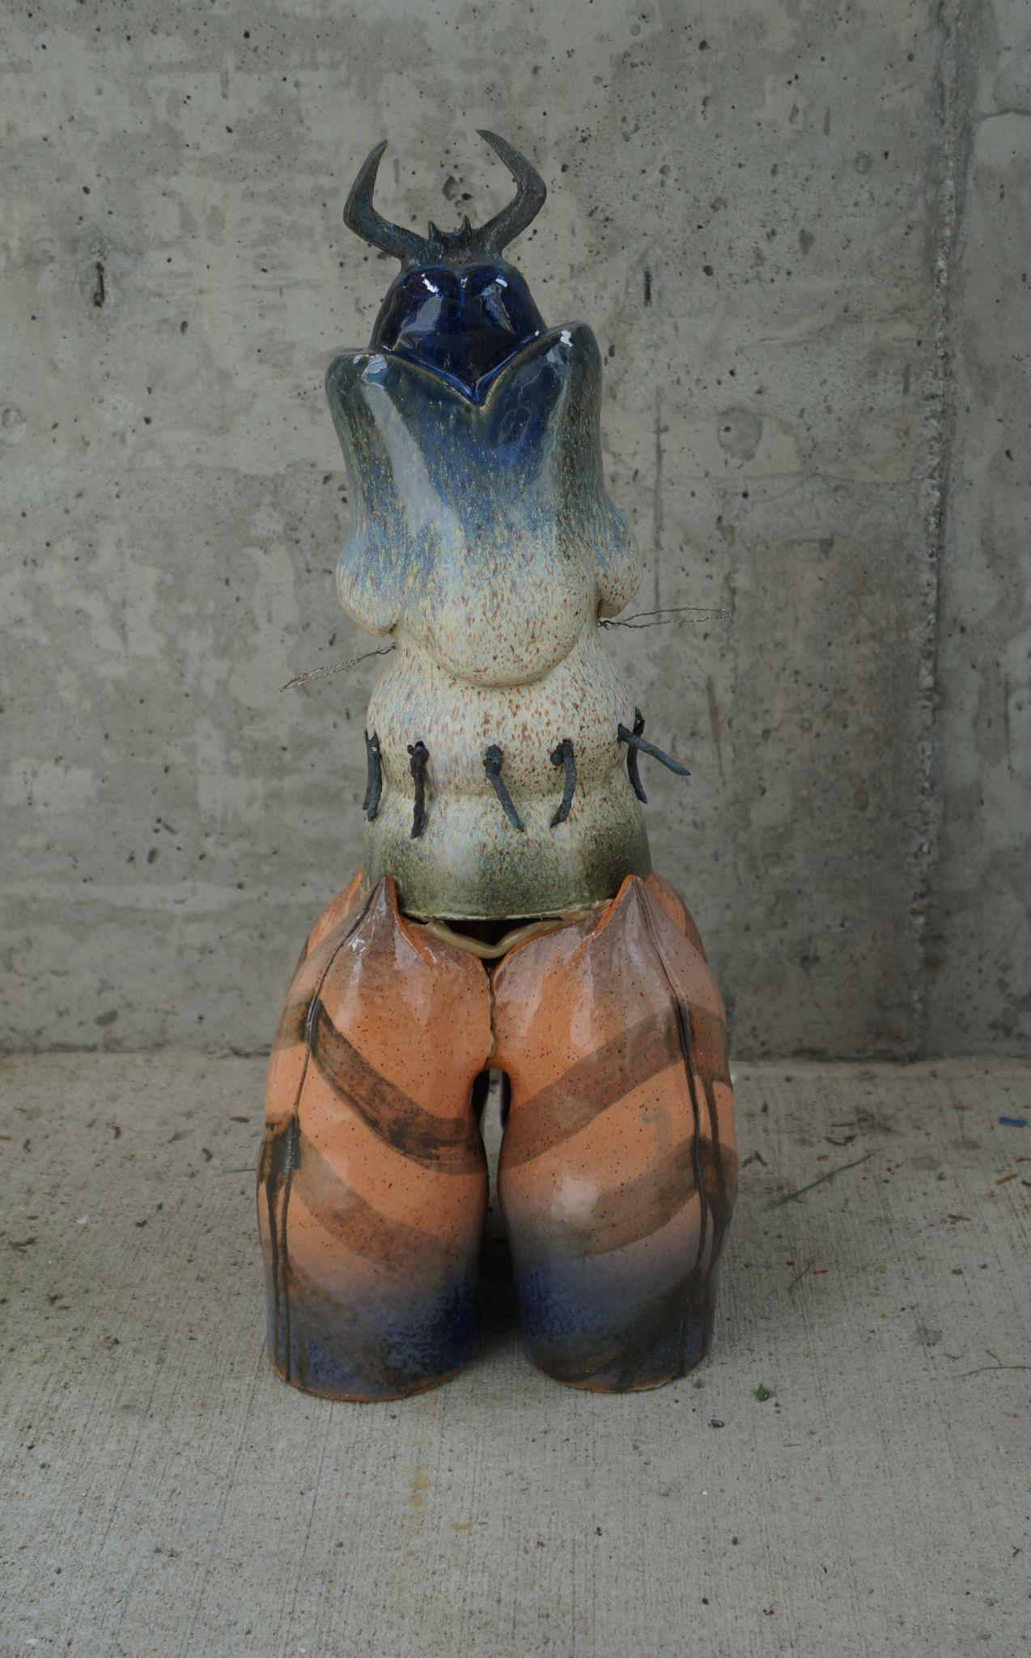
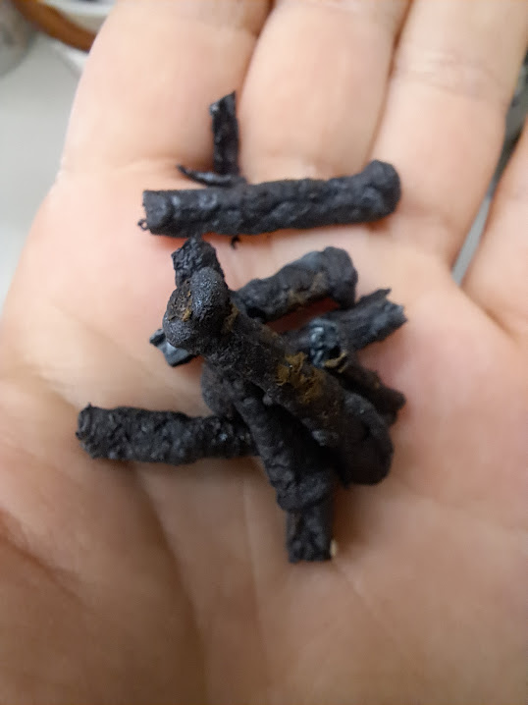

Slide 16
9 glazes were used in total – 6 made from scratch, and 3 modified versions of a glaze already available in the pomoarts ceramics studio
heino render F + H – satin-matte, semi-transparent. recipe from john britt
nebula A + B – semi-lava. recipe from linda bloomfield
marilee’s concrete – full lava. recipe from john britt
manganese copper – copper metallic. recipe from linda bloomfield
cottage white F + G + H – the base cottage white glaze with added stains
the lava, metallic, and semi-lava glazes were made to emulate concretes and metals. the palette of the glazes was based on subdued versions of colours found at construction sites, on official cov signs, and the colouring of referenced creatures/plants.
the palette decisions for each individual piece were a mix of reference, attempts at unity, and spur-of-the-moment decisions.
Notes:
GLAZES

Slide 17
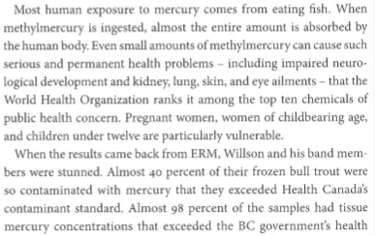
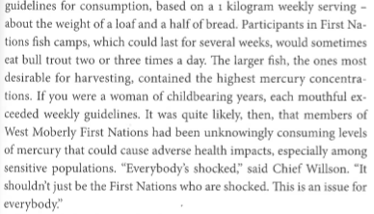
Cox, Sarah. Breaching the Peace: the Site C Dam and a Valley’s Stand Against Big Hydro. On Point Press, 2018, pp. 118-119.
Notes:
breaching the piece by sarah cox on the site c dam; here we read about how willson discovered high amounts of neurotoxic mercury (a liquid metal) in the trout his family and bans harvested from crooked river, near the williston reservoir

Slide 18
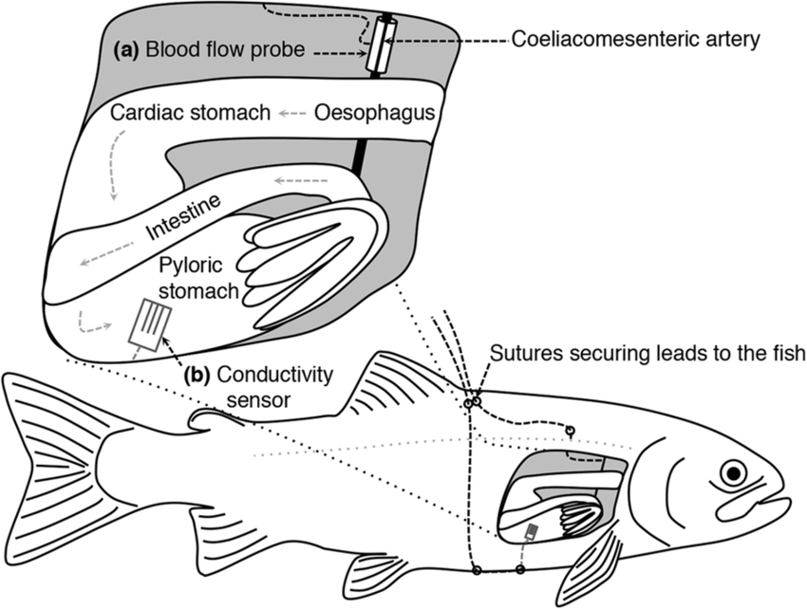
rainbow trout blood flow
Brijs, Jeroen and Albin Gräns. “Schematic drawing of surgical instrumentation.” Increased gastrointestinal blood flow: An essential circulatory modification for euryhaline rainbow trout (Oncorhynchus mykiss) migrating to sea, Scientific Reports, 22 May 2015, https://www.nature.com/articles/srep10430.
Notes:
study measuring air flow, stomach conductivity, and water salinity levels during trout’s transfer from fresh water to sea water

Slide 19
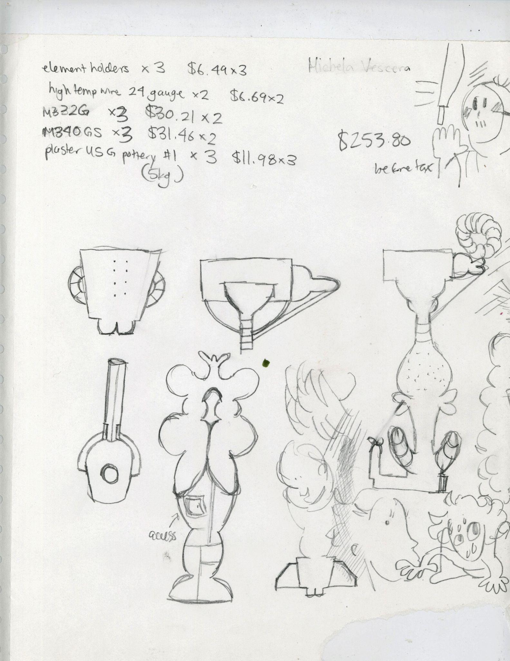
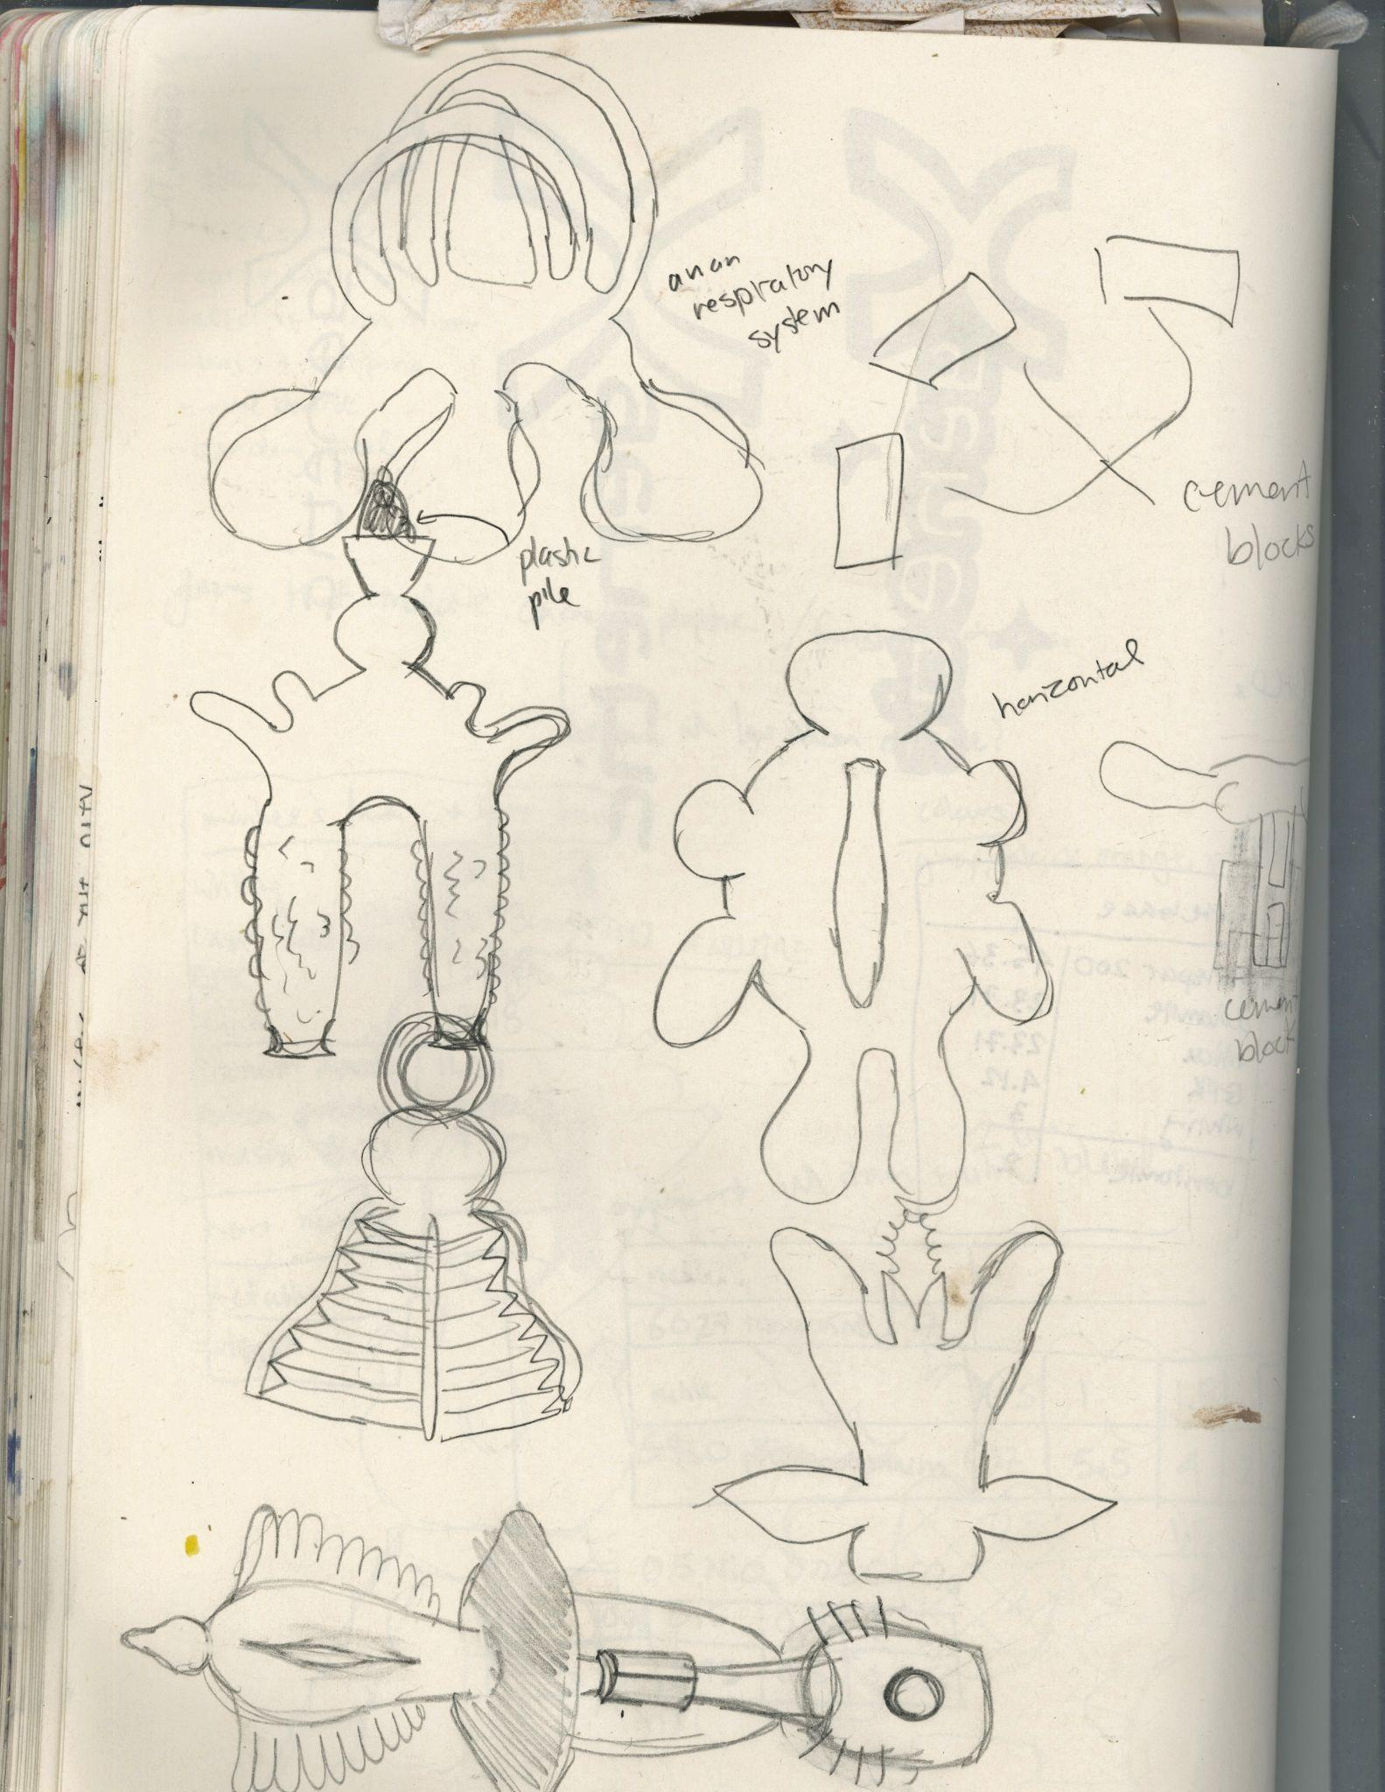

Slide 20
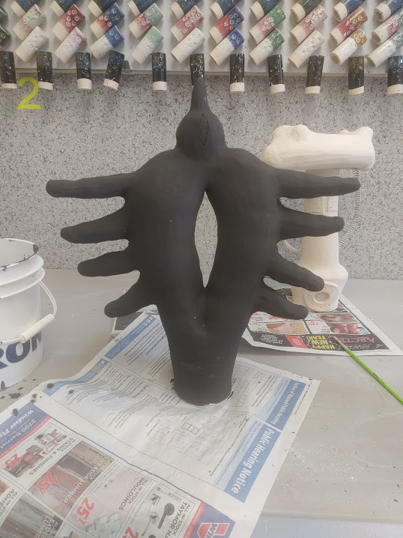
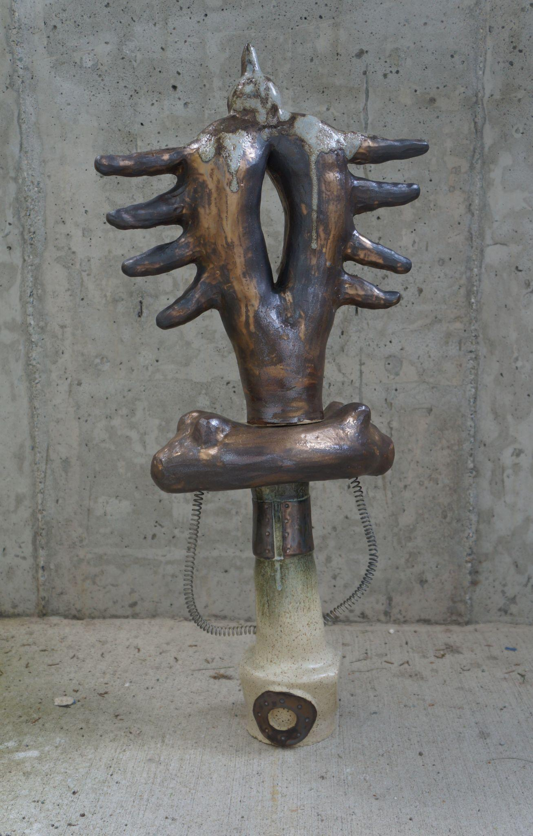

Slide 21
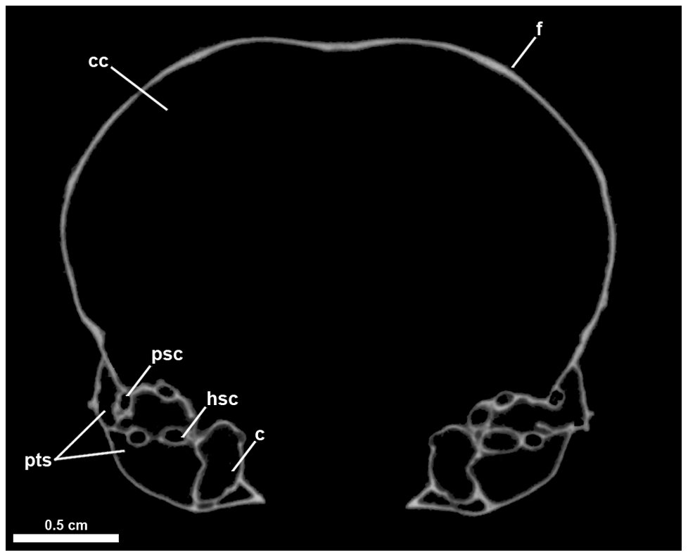
marbled murrelet coronal slice
Clarke, A. Julia and N. Adam Smith. “Figure 10.” Endocranial Anatomy of the Charadriiformes: Sensory System Variation and the Evolution of Wing-Propelled Diving, Plos One, 27 Nov 2012, https://doi.org/10.1371/journal.pone.0049584.
marbled murrelet endocast
Clarke, A. Julia and N. Adam Smith. “Figure 10.” Endocranial Anatomy of the Charadriiformes: Sensory System Variation and the Evolution of Wing-Propelled Diving, Plos One, 27 Nov 2012, https://doi.org/10.1371/journal.pone.0049584.
Notes:
murrelet is second row

Slide 22
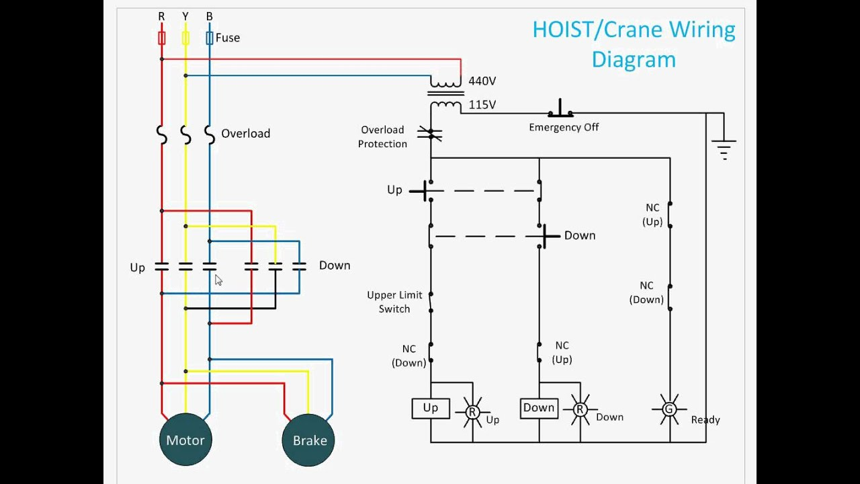
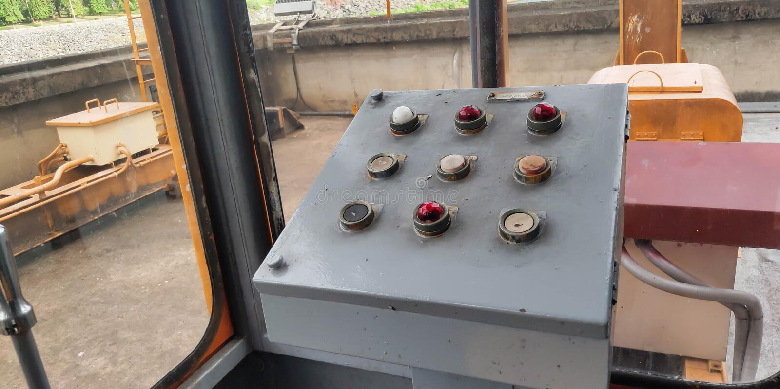
hoist circuit
“Hoist Control Circuit.” YouTube, uploaded by bmanishap, 27 May 2012, https://www.youtube.com/watch?v=__k2dSfTC0E.
vintage crane control panel
Pathong, Piamsak. “Old Crane control panel.” Dreamstime, https://www.dreamstime.com/old-crane-control-panel-industrial-work-old-crane-control-panel-image157633277.

Slide 23
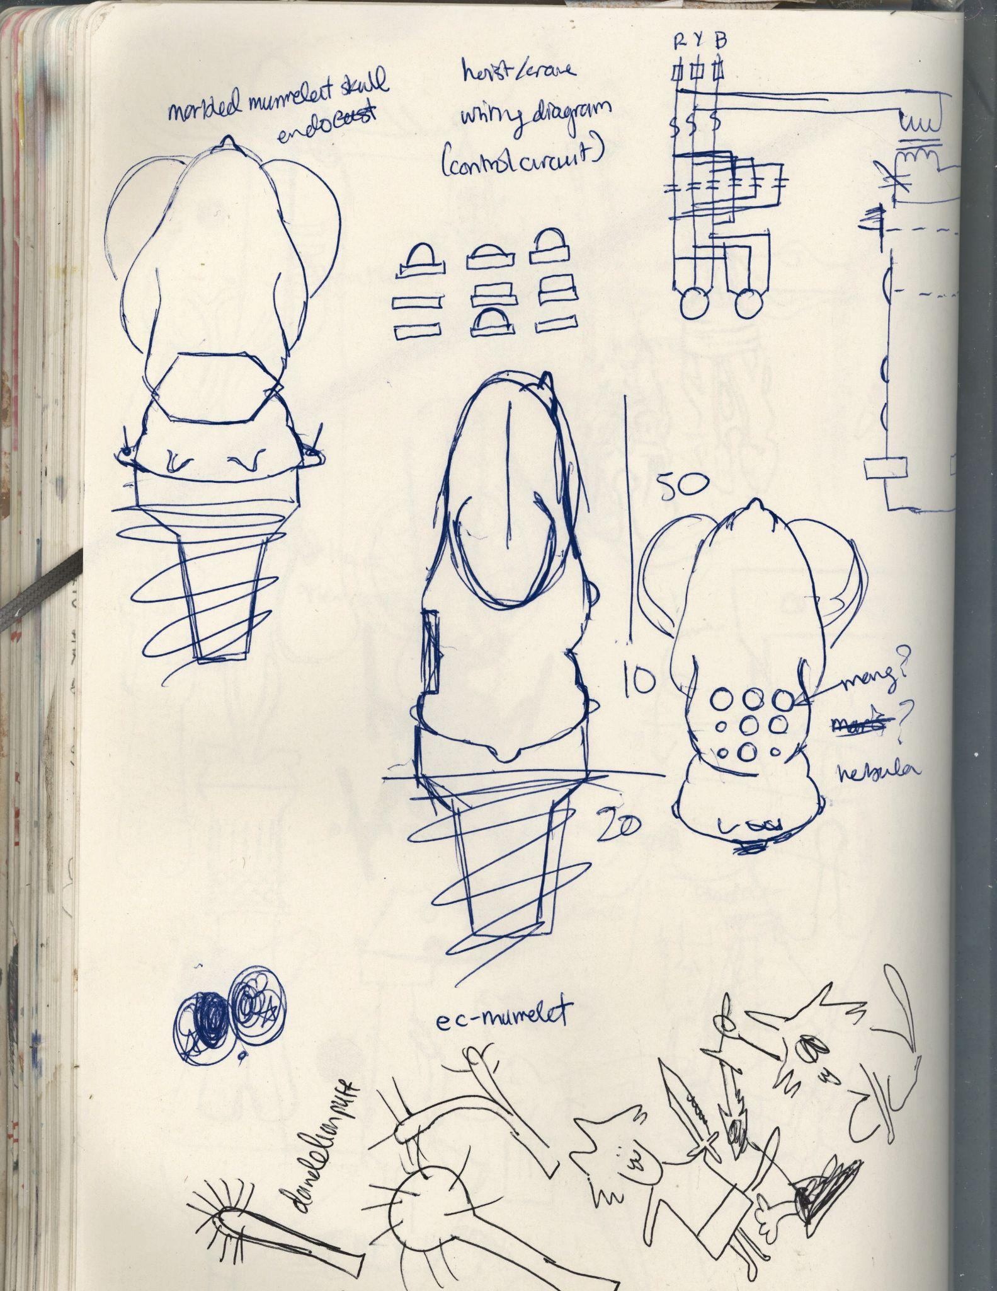
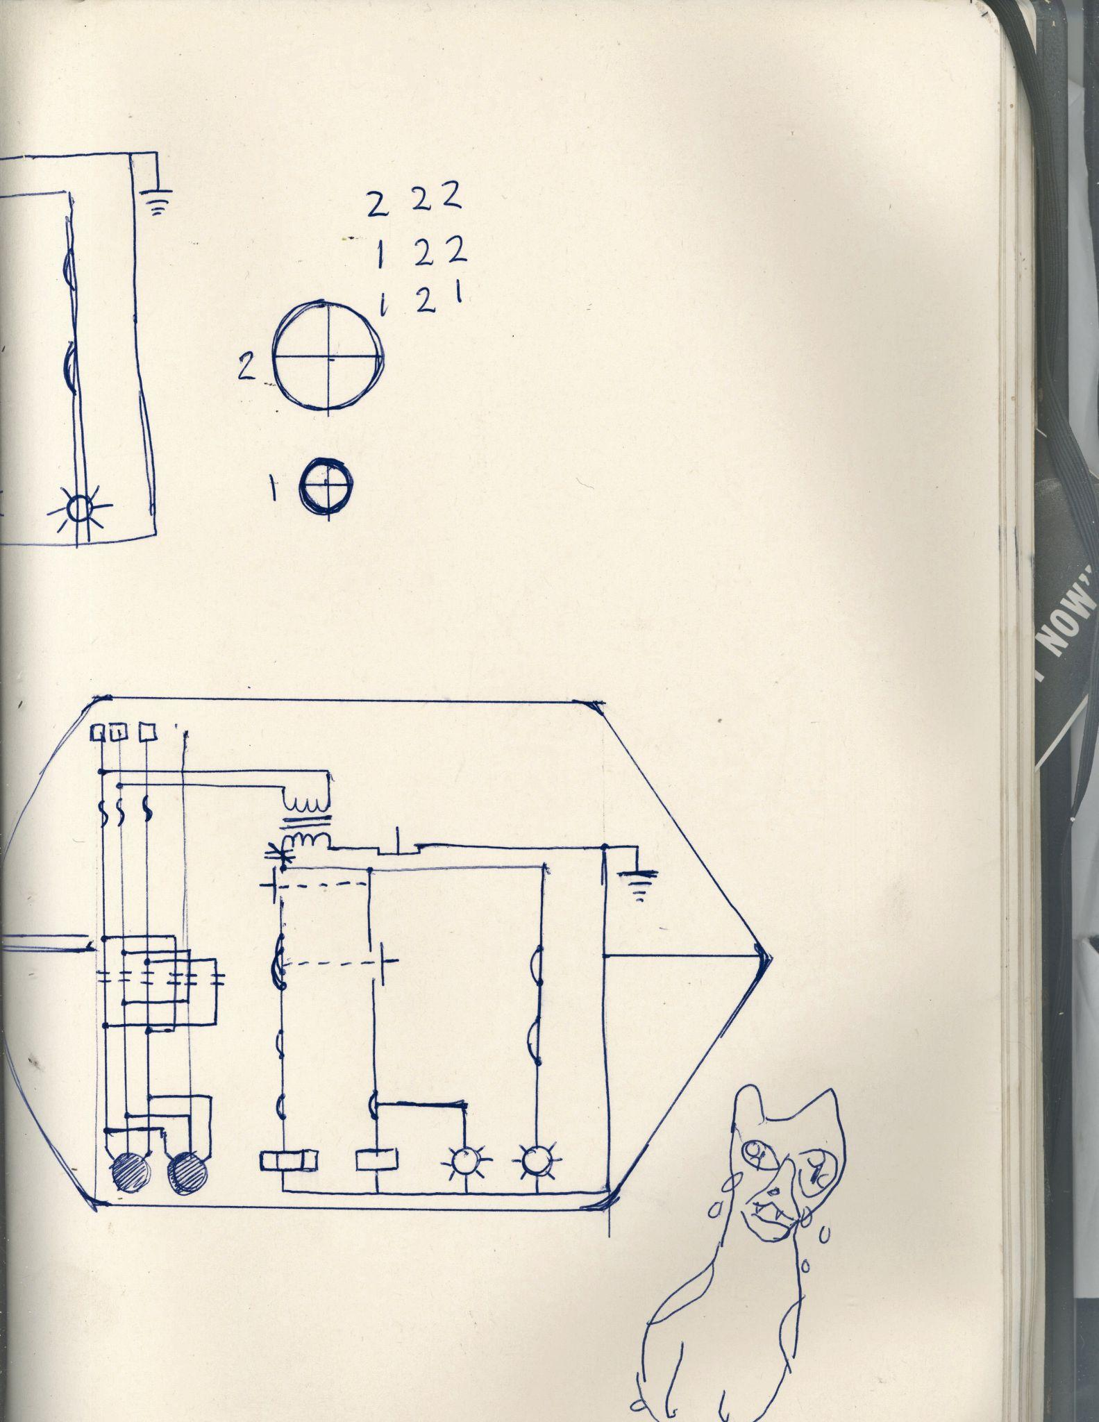

Slide 24
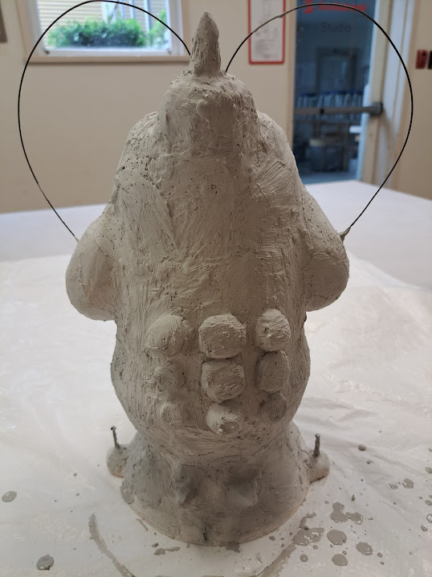

Slide 25
rangifer tarandus hindlimb
Hull, E. “Hindlimb, abaxial aspect.” Tendons and ligaments of the Rangifer tarandus metapodial and hoof, Polar Biology, Sep 2020, https://www.researchgate.net/publication/353480215_Tendons_and_ligaments_of_the_Rangifer_tarandus_metapodial_and_hoof.
rangifer tarandus forelimb
Hull, E. “Bones of the forelimb.” Tendons and ligaments of the Rangifer tarandus metapodial and hoof, Polar Biology, Sep 2020, https://www.researchgate.net/publication/353480215_Tendons_and_ligaments_of_the_Rangifer_tarandus_metapodial_and_hoof.
Notes:
rangifer tarandus is a species including both reindeer and caribou

Slide 29
bird respiratory system
“Abdominal air sacs.” Bird Respiratory System, Gary Ritchison’s Avian Biology, http://people.eku.edu/ritchisong/birdrespiration.html.

Slide 31
Notes:
hammer of pile driver

Slide 32
fish cardiovascular system
Steffenson, J.F. “Fig. 8.” Fish Physiology: The Cardiovascular System, edited by Hoar, W..S., et al., Academic Press, Inc., 1992, pp. 197.
pile driver
“STR20.” STR20, Hercules Machinery Corporation, https://hmc-us.com/resources/equipment/solar-foundation/str20.

Slide 33
pile driver diesel hammer
“Figure 9. Single-acting diesel hammer.” Design and Construction of Driven Pile Foundations. Federal Highway Administration, 2016, https://www.fhwa.dot.gov/publications/research/infrastructure/geotechnical/05159/chapter3.cfm.
Notes:
pile driver hammer

Slide 36
rainbow trout
Carlson, Dave. “Bony Fish Anatomy - Rainbow Trout 1.” Carlson Stock Art, https://www.carlsonstockart.com/photo/fish-bony-anatomy-rainbow-trout-illustration-1/.

Slide 39
saduria entomon brain
Kenning, Mathes. “Figure 2. General overview of the brain in Saduria entomon.” Brain anatomy of the marine isopod Saduria entomon Linnaeus, 1758 (Valvifera, Isopoda) with special emphasis on the olfactory pathway. PubMed, Oct 2013, https://www.researchgate.net/publication/257600304_Brain_anatomy_of_the_marine_isopod_Saduria_entomon_Linnaeus_1758_Valvifera_Isopoda_with_special_emphasis_on_the_olfactory_pathway.

Slide 42
moose field dressing
“Field Dressing Your Moose.” Moose Field Techniques and Game Care, New Hampshire Fish and Game Department, https://www.wildlife.state.nh.us/hunting/moose-game-care.html.
moose reproductive/excretory system
“Warning!!!” Moose Field Techniques and Game Care, New Hampshire Fish and Game Department, https://www.wildlife.state.nh.us/hunting/moose-game-care.html.

Slide 45
chickadee reproductive/excretory system
“Reproductive & Excretory Systems.” Reproduction/Development, Black Capped Chickadee Resource,, http://blackcappedchickadeeresource.weebly.com/reproductiondevelopment.html.
bird syrinx
Goller, Franz and R.A. Suthers. “The songbird syrinx….” The neuromuscular control of birdsong, PubMed, 1999, https://www.researchgate.net/publication/12917420_The_neuromuscular_control_of_birdsong.

Slide 48
oniscus asellus
Becking, Thomas, et al. “Figure 4.” Diversity and evolution of sex determination systems in terrestrial isopods. Sci Rep, vol. 7, 2017, https://doi.org/10.1038/s41598-017-01195-4.
Notes:
terrestrial isopod

Slide 50
rat brain
Krumholtz, Stacey-Lynn. “Rat Brain Anatomy (Ventral Aspect).” Rat Brain Anatomy, SLK ART, http://www.slk-art.com/rat-brain-anatomy/i4e5ga5cmbtv3bcbux9ffqwed04v.

Slide 53
lichen thallus
Parker, Nina et al. “Figure 5.38.” Microbiology, OpenStax, 1 Nov 2016, https://openstax.org/books/microbiology/pages/5-5-lichens.

